Slide 1

Make every vote count
Notes:
[Note: Feel free to adapt this introduction to suit yourself. A personal story about why you are concerned about PR is a wonderful start.]
Hello! My name is _________________ and I’m delighted to be here to discuss making every vote count.

Slide 2
Outline
What are appropriate electoral reform principles?
Which electoral systems are other countries using?
How do these electoral systems work?
Do these systems deliver on the principles?
Questions and Responses
Where to find more information
Notes:
[Click] The outline for the presentation is to:
[Click] talk more about the criteria by which we might evaluate parliament
[Click] look at the systems other countries are using
[Click] explore how those systems work
[Click] ask whether they deliver the kind of parliament Canadians want
We’ll close with a brief summary and a time for questions. Questions of clarification are also welcome as we go along.

Slide 3
Parliamentary Committee’s Electoral Reform Principles
1) Effectiveness and legitimacy: that the proposed measure would increase public confidence among Canadians that their democratic will, as expressed by their votes, will be fairly translated and that the proposed measure reduces distortion and strengthens the link between voter intention and the election of representatives;
2) Engagement: that the proposed measure would encourage voting and participation in the democratic process, foster greater civility and collaboration in politics, enhance social cohesion and offer opportunities for inclusion of underrepresented groups in the political process;
3) Accessibility and inclusiveness: that the proposed measure would avoid undue complexity in the voting process, while respecting the other principles, and that it would support access by all eligible voters regardless of physical or social condition;
4) Integrity: that the proposed measure can be implemented while safeguarding public trust in the election process, by ensuring reliable and verifiable results obtained through an effective and objective process that is secure and preserves vote secrecy for individual Canadians;
5) Local representation: that the proposed measure would ensure accountability and recognize the value that Canadians attach to community, to Members of Parliament understanding local conditions and advancing local needs at the national level, and to having access to Members of Parliament to facilitate resolution of their concerns and participation in the democratic process;
Notes:
[Click] The committee’s recommendations are supposed to respect five core principles. Now, this is a lot of text, so I’ve summarized on the next slides.

Slide 4
Value | Definition
Effectiveness & Legitimacy | fairly translate votes into representatives
Engagement
Accessibility & Inclusiveness
Integrity
Local Representation
Notes:
So there’s the list of criteria.
In a few moments we’ll start looking at a number of ways to run elections. For each one, we want to come back to look at this list and ask how it rates.

Slide 5
Value | Definition
Effectiveness & Legitimacy | fairly translate votes into representatives
Engagement | encourage voting foster greater civility and collaboration in politics enhance social cohesion include underrepresented groups
Accessibility & Inclusiveness
Integrity
Local Representation
Notes:
So there’s the list of criteria.
In a few moments we’ll start looking at a number of ways to run elections. For each one, we want to come back to look at this list and ask how it rates.

Slide 6
Value | Definition
Effectiveness & Legitimacy | fairly translate votes into representatives
Engagement | encourage voting foster greater civility and collaboration in politics enhance social cohesion include underrepresented groups
Accessibility & Inclusiveness | avoid undue voting complexity while respecting other principles
Integrity
Local Representation
Notes:
So there’s the list of criteria.
In a few moments we’ll start looking at a number of ways to run elections. For each one, we want to come back to look at this list and ask how it rates.

Slide 7
Value | Definition
Effectiveness & Legitimacy | fairly translate votes into representatives
Engagement | encourage voting foster greater civility and collaboration in politics enhance social cohesion include underrepresented groups
Accessibility & Inclusiveness | avoid undue voting complexity while respecting other principles
Integrity | safeguard trust in the election process give reliable and verifiable results
Local Representation
Notes:
So there’s the list of criteria.
In a few moments we’ll start looking at a number of ways to run elections. For each one, we want to come back to look at this list and ask how it rates.

Slide 8
Value | Definition
Effectiveness & Legitimacy | fairly translate votes into representatives
Engagement | encourage voting foster greater civility and collaboration in politics enhance social cohesion include underrepresented groups
Accessibility & Inclusiveness | avoid undue voting complexity while respecting other principles
Integrity | safeguard trust in the election process give reliable and verifiable results
Local Representation | ensure accountable MPs ensure accessible MPs MPs understand local conditions & advance local needs
Notes:
So there’s the list of criteria.
In a few moments we’ll start looking at a number of ways to run elections. For each one, we want to come back to look at this list and ask how it rates.

Slide 9
Value | Definition
Effectiveness & Legitimacy | fairly translate votes into representatives
Engagement | encourage voting foster greater civility and collaboration in politics enhance social cohesion include underrepresented groups
Accessibility & Inclusiveness | avoid undue voting complexity while respecting other principles
Integrity | safeguard trust in the election process give reliable and verifiable results
Local Representation | ensure accountable MPs ensure accessible MPs MPs understand local conditions & advance local needs
Good Governance | yield stable governments governments that enact long-lasting policies supported by the majority of voters
Notes:
So there’s the list of criteria.
In a few moments we’ll start looking at a number of ways to run elections. For each one, we want to come back to look at this list and ask how it rates.

Slide 10
Value | Definition
Effectiveness & Legitimacy | fairly translate votes into representatives
Engagement | encourage voting foster greater civility and collaboration in politics enhance social cohesion include underrepresented groups
Accessibility & Inclusiveness | avoid undue voting complexity while respecting other principles
Integrity | safeguard trust in the election process give reliable and verifiable results
Local Representation | ensure accountable MPs ensure accessible MPs MPs understand local conditions & advance local needs
Good Governance | yield stable governments governments that enact long-lasting policies supported by the majority of voters
Notes:
So there’s the list of criteria.
In a few moments we’ll start looking at a number of ways to run elections. For each one, we want to come back to look at this list and ask how it rates.

Slide 11

Types of Electoral Systems
Electoral Systems
Winner-Take-All Systems
Proportional
Systems
First-Past-The-Post
Alternative Vote
Multi-Member
Mixed Member
Rural-Urban Proportional
Notes:
[Click] The first thing to know is that there are many different electoral systems. They break down into two main families,
[Click] winner-take-all, and [Click] proportional systems.
In the winner-take-all family the most prominent system is known as [Click] first-past-the-post. It’s what Canada uses now.
Another winner-take-all-system that has received attention recently is known as [Click] alternative vote. It’s also known as instant run-off voting. There are other winner-take-all systems, as indicated by these extra boxes.
In the proportional family of electoral systems, [Click] one group is multi-member systems and the other is [Click] mixed member systems.
Again, there are many variations on these systems. We’ll look at one representative from each group.
=============== BACKGROUND
The first family is Majoritarian systems (like we have now) that elect a single person for each riding and each election is completely independent of all the others. First-Past-The-Post or FPTP is what Canada uses now. A variation of that system, Alternative Vote, is often talked about as an improvement on FPTP. Fair Vote believes that any proportional system is far better than any majoritarian system, including the Alternative Vote.
The second family of voting systems is Proportional Systems. There are at least two clans within this family. We’ll take a look at a representative member of each clan.
Alternative Vote is stacked in the graphic because there are a bunch of ways to count a ranked ballot. For example:
Successively dropping the candidate with the fewest first-place votes (AV)
Successively dropping the candidate with the most last-place votes
Ranked pairs (a version of Condorcet)
Borda count
Approval voting
Etc
However, these all elect a single person to represent the whole riding – and are thus not that different from FPTP. Almost everything in this list is better than AV, but not by much.
Similarly, Multi-Member and Mixed Member are stacked because there are also many variations on what we present here.
It’s worth stressing that there are many ways to do PR and that we can tailor a system to Canada.

Slide 12
Who is Using What?
Winner-Take-All Systems:
First-Past-The-Post:
  United States
  Canada
  Singapore
  United Kingdom
Alternative Vote:
  Australia
Other:
  France, Bahrain, Belarus
Proportional Systems:
Multi-Member
  Norway
  Switzerland
  Denmark
  Netherlands
  Ireland
  Liechtenstein
  Sweden
  Iceland
  Israel
  Luxembourg
  Belgium
  Austria
  Finland
  Slovenia
  Spain
  Italy
  Czech Republic
  Greece
  Estonia
  Cyprus
  Slovakia
  Poland
  Malta
  Argentina
  United Arab Emirates
  Chile
  Portugal
  Latvia
  Croatia
  Kuwait
  Montenegro
Mixed Member
  Germany
  New Zealand
  Hungary
Parallel Systems
  South Korea
  Japan
  Andorra
  Lithuania
Looking at democracies scoring “very high” on the UN’s Human Development Index.
Notes:
[Click] But first, which countries are already using these systems?
For this comparison, we’re really interested in countries like Canada – similar in values, life style, and (of course) democracies. We’re using countries ranked “very high” on the United Nation’s Human Development index as a benchmark.
[Click] Let’s look first at countries using a Winner-Take-All system.
On the UN’s Human Development Index, there are four countries that use first-past-the-post. [Click] Canada, of course, the United States, Singapore and the United Kingdom. All four have close historical ties in the development of their democracies.
[Click] The only country on the list to use the Alternative Vote is Australia.
[Click] A couple use a two-round system that we won’t discuss.
[Click] On the other hand, here are all the countries on the UN list that use some form of proportional representation. Some of the prominent ones are New Zealand, Germany, and many other European countries.
[We have received gasps of surprise at this last one. Be sure to stay here long enough for it to sink in!]
[Click] Finally, there are a couple that use Parallel systems that mix winner-take-all and proportional.
==================
Notes: Within each group the countries are listed in HDI order.
How this list was created:
Take the countries ranked “very high” on the UN’s Human Development Index (http://www.nationsonline.org/oneworld/human_development.htm; actual list from https://en.wikipedia.org/wiki/List_of_countries_by_Human_Development_Index). Remove non-democracies like Saudia Arabia, UAE, Qatar, Cuba. Cross-reference that with http://www.idea.int/db/fieldview.cfm?field=154#tableTab1 to get the electoral system used.
There are lots of other countries that use FPTP, but they aren’t high on the UN’s Human Development Index – in other words most of us would not choose to live in those countries unless we had family or something there.
The Human Development Index (HDI) is a summary measure of average achievement in key dimensions of human development: (1) a long and healthy life, (2) being knowledgeable and (3) have a decent standard of living. (http://hdr.undp.org/en/content/human-development-index-

Slide 13
Types of Electoral Systems
Electoral Systems
Winner-Take-All Systems
Proportional
Systems
First-Past-The-Post
Alternative Vote
Multi-Member
Mixed Member
Rural-Urban Proportional
Notes:
[Click] The first thing to know is that there are many different electoral systems. They break down into two main families,
[Click] winner-take-all, and [Click] proportional systems.
In the winner-take-all family the most prominent system is known as [Click] first-past-the-post. It’s what Canada uses now.
Another winner-take-all-system that has received attention recently is known as [Click] alternative vote. It’s also known as instant run-off voting. There are other winner-take-all systems, as indicated by these extra boxes.
In the proportional family of electoral systems, [Click] one group is multi-member systems and the other is [Click] mixed member systems.
Again, there are many variations on these systems. We’ll look at one representative from each group.
=============== BACKGROUND
The first family is Majoritarian systems (like we have now) that elect a single person for each riding and each election is completely independent of all the others. First-Past-The-Post or FPTP is what Canada uses now. A variation of that system, Alternative Vote, is often talked about as an improvement on FPTP. Fair Vote believes that any proportional system is far better than any majoritarian system, including the Alternative Vote.
The second family of voting systems is Proportional Systems. There are at least two clans within this family. We’ll take a look at a representative member of each clan.
Alternative Vote is stacked in the graphic because there are a bunch of ways to count a ranked ballot. For example:
Successively dropping the candidate with the fewest first-place votes (AV)
Successively dropping the candidate with the most last-place votes
Ranked pairs (a version of Condorcet)
Borda count
Approval voting
Etc
However, these all elect a single person to represent the whole riding – and are thus not that different from FPTP. Almost everything in this list is better than AV, but not by much.
Similarly, Multi-Member and Mixed Member are stacked because there are also many variations on what we present here.
It’s worth stressing that there are many ways to do PR and that we can tailor a system to Canada.

Slide 14
First-Past-The-Post
Canada uses FPTP now
In each riding, the candidate with the most votes wins
Notes:
[Click] FPTP is the system that Canada has used since 1867. It’s a simple system – in each riding the candidate with the most votes wins and becomes the MP for that riding.
That simplicity, however, produces many ill effects. It’s important that we take a few moments to understand them.

Slide 15
FPTP results are often unfair
“False Majority”
Notes:
[Click] This charts shows the results of the 2015 Federal election. The bottom set of bars shows that the Liberals earned about 40% of the popular vote but received 54% of the seats in Parliament.
Those extra seats came at the expense of the Conservatives, New Democrats, Bloc, and Green candidates – who all received fewer seats than their share of the popular vote would indicate.
To make matters worse, the first-past-the-post system turned that 40% minority of the votes into a majority of the seats in Parliament. That is, the Liberals received 100% of the power in Parliament with less than 40% of the votes.
When this happens, it’s called a “False Majority”. [Click]
By the way, that’s almost exactly what happened in the previous election except that the Conservatives received 100% of the power with just under 40% of the votes.

Slide 16
FPTP results are often unfair
“False Majority”
Notes:
[Click] This charts shows the results of the 2011Federal election. Almost exactly the same as 2015, just the colours are different!

Slide 17
FPTP false majorities are common
Notes:
[Click] We could hope that false majorities would be rare – but they are not. Since 1930, half of our governments have been false majorities. Of the 26 elections since 1930, only 4 of them have resulted in a true majority government.

Slide 18
FPTP can be really unfair
Notes:
[Click] First-past-the-post can be really unfair, too.
Consider the 1987 New Brunswick election. The Liberals earned a legitimate majority government with about 60% of the vote. But first-past-the-post gave them every single seat in the legislature. Not a single opposition MLA was elected.
Stop and think for a moment on the effect that has on democracy. Who holds the government to account? Who represents the 40% of voters who did not want a Liberal government?
What we’ve seen in the last four slides is that first-past-the-post often exaggerates the winning party, giving them more than their fair share of the seats.

Slide 19
FPTP magnifies regional differences
Notes:
FPTP can make us appear much more divided than we really are, undermining our social cohesion.

Slide 20
FPTP tends to elect few women
Notes:
[Click] Let’s shift now to the other way of looking at diversity: does Parliament approximately match the diversity of Canadians in gender, ethnicity, orientation, religion, or any other measure one might reasonably propose?
One of our most basic identities is gender. This slide compares the percentage of women elected to national legislatures in eleven different countries. We see that those countries using some form of proportional representation elect more women than those using a single-winner system like first-past-the-post.
First-past-the-post fails to fairly reflect our diversity.
================= Background
This data is from page 9 of Fair Vote Canada’s publication “A Case for Support – A Case for Democracy”, published Nov. 2014.
The 2015 election barely changed these numbers. Canada got up to 26% women in Parliament.

Slide 21
FPTP: Like-minded MPs
2015 Federal Election
Notes:
[Click] Another criteria we had for Parliament dealt with local representation. One of the strengths of first-past-the-post is that MPs are local.
But one of the weaknesses is that each riding has only one MP – which may not see the issues the same way that you do. In fact, after the 2015 Federal election, only 49% of Canadian voters were represented by an MP from the party they voted for.
This implies that just over half of the voters could have stayed home without affecting the outcome at all. No wonder so many actually do stay home.
In proportional systems most voters have a representative from the same party they voted for.

Slide 22
FPTP: Elections since WWII
Canada (FPTP)
22
Ireland (PR)
19
Germany (PR)
18
Switzerland (PR)
18
Italy
17
Pilon: 1945-1998 FPTP countries averaged 16.7 elections; PR countries averaged 16.0.
Notes:
[Click] We should expect good governance from Parliament, meaning that they make long-lasting decisions supported by most but with enough stability that they can also make the occasional tough call.
First-past-the-post is often said to yield stable governments because it tends to produce majority governments.
But the data suggests otherwise. Canada has had 22 elections since WW II. [Click] That’s more than many proportional representation countries, including Ireland, Germany, and Switzerland. It’s even more elections than Italy, a sort-of PR country that is often accused of being unstable.

Slide 23
FPTP: Policy Lurch
Notes:
[Click] What about long-lasting policies supported by most Canadians? Our last couple of governments have illustrated Canada’s problem with “policy lurch”.
A government with a false majority forces through a policy that lacks widespread support, only to have it undone by a future government of a different stripe.
Such policy lurch makes it difficult for businesses, public institutions, and families to plan for the future.
Research has shown that countries with proportional representation have more collaboration among parties that results in longer-lasting policies.
For a Canadian example, consider the minority government of Lester B. Pearson. Cross-party cooperation resulted in the health care system as we now know it, our flag, and the Canada Pension Plan.
==============
Slide Based on https://www.facebook.com/FairVoteCanada/photos/pb.39315431246.-2207520000.1455591847./10153303404391247/?type=3&theater

Slide 24
Types of Electoral Systems
Electoral Systems
Winner-Take-All Systems
Proportional
Systems
First-Past-The-Post
Alternative Vote
Multi-Member
Mixed Member
Rural-Urban Proportional
Notes:
[Click] The first thing to know is that there are many different electoral systems. They break down into two main families,
[Click] winner-take-all, and [Click] proportional systems.
In the winner-take-all family the most prominent system is known as [Click] first-past-the-post. It’s what Canada uses now.
Another winner-take-all-system that has received attention recently is known as [Click] alternative vote. It’s also known as instant run-off voting. There are other winner-take-all systems, as indicated by these extra boxes.
In the proportional family of electoral systems, [Click] one group is multi-member systems and the other is [Click] mixed member systems.
Again, there are many variations on these systems. We’ll look at one representative from each group.
=============== BACKGROUND
The first family is Majoritarian systems (like we have now) that elect a single person for each riding and each election is completely independent of all the others. First-Past-The-Post or FPTP is what Canada uses now. A variation of that system, Alternative Vote, is often talked about as an improvement on FPTP. Fair Vote believes that any proportional system is far better than any majoritarian system, including the Alternative Vote.
The second family of voting systems is Proportional Systems. There are at least two clans within this family. We’ll take a look at a representative member of each clan.
Alternative Vote is stacked in the graphic because there are a bunch of ways to count a ranked ballot. For example:
Successively dropping the candidate with the fewest first-place votes (AV)
Successively dropping the candidate with the most last-place votes
Ranked pairs (a version of Condorcet)
Borda count
Approval voting
Etc
However, these all elect a single person to represent the whole riding – and are thus not that different from FPTP. Almost everything in this list is better than AV, but not by much.
Similarly, Multi-Member and Mixed Member are stacked because there are also many variations on what we present here.
It’s worth stressing that there are many ways to do PR and that we can tailor a system to Canada.

Slide 25
Alternative Vote
Uses a ranked ballot
When counted, the candidate with the least votes is dropped and those ballots redistributed to the next ranked candidate. Repeat until someone has 50%+1.
Notes:
[Click] Alternative Vote uses a ranked ballot, which is different from what we’re used to. Many other electoral systems also use a ranked ballot.
[Click] A ranked ballot simply means that voters can say who their second, third, and fourth choices are – in addition to their first choice.
[Click] These choices are taken into account when the ballots are counted. The general idea of Alternative Vote is to count the ballots using the top-ranked remaining candidate on each ballot. If a candidate gets 50%+1, he or she wins. Otherwise, drop the least popular candidate, redistribute those ballots, and count again.
Let’s look at an example.

Slide 26
Alternative Vote Counting
Con 38%
NDP 29%
Lib 26%
Grn 5%
Ind 2%
1%
1%
Con 39%
NDP 29%
Lib 26%
Grn 6%
1%
5%
Con 40%
NDP 29%
Lib 31%
8%
21%
Con 48%
Lib 52%
Notes:
[Click] In this election, the conservative candidate received 38% of the first-place votes, the NDP candidate received 29% of the first place votes, and so on for the other candidates.
The Independent candidate is least popular and is dropped. [Click] The 2% of the ballots that listed the Independent candidate first are redistributed to their second place candidate. Let’s suppose that half of them go to the Greens and half to the Conservatives.
[Click] We now pretend that first round never happened. At this point we pretend that 39% ranked the Conservative candidate first, even though we know that some of them really ranked them second.
Once again, we drop the least popular candidate, in this case the Green. Their votes are redistributed.
[Click] We’re now left with 40% for the Conservative candidate, 29% for the NDP, and 31% for the Liberal candidate. [Click] Once again, we drop the least popular candidate and redistribute their votes, giving the Liberal candidate the win (in this example).

Slide 27
Alternative Vote Results
Usually gives same winner as FPTP
  Always favours larger parties over smaller ones
  Favours centrist parties over others
  Simulation using 2015 data gives Liberals 213 seats instead of 184 (24% over-representation instead of 15%).
Unfair results
Limited diversity
Many voters without a like-minded representative
Notes:
[Click] Alternative Vote has been used in Australia and a number of municipalities. In those jurisdictions it has usually elected the same candidate that would have won under first-past-the-post.
In those cases where it does elect someone different – like in our example, it tends to favour bigger parties and centrist candidates. A simulation with 2015 data shows the Liberals gaining even more undeserved seats.
Because it generally elects the same candidate as first-past-the-post, it’s subject to the same results: unfair representation, limited diversity, and many voters without a like-minded representative.
Note: Greens, for example, won’t do any better under AV than FPTP unless they substantially increase their vote share.

Slide 28
But people will vote differently!
http://election-modelling.ca/av/index.html
Notes:
This is a complicated graph. I’m happy to discuss it in more detail at the end of the presentation. For now, I’ll just say that it takes a lot of people voting differently to overcome the unfairness that is built into Alternative Vote.
Background:
This is based on 6 simulations of Alternative Vote using the 2015 data. In each case a different percentage of the votes in each riding are shifted. For example, at the far left, 30% of the Liberal votes in each riding are shifted to the NDP – and the Liberals still get more MPs than they should (light red line vs. heavier read line).
On the right side of the graph, votes are shifted from the NDP to the Liberals – with devastating effects on the NDP.

Slide 29
Value | Definition | Winner Take All | Propor-tional
Effectiveness & Legitimacy | fairly translate votes into representatives | ✗
Engagement | encourage voting foster greater civility and collaboration enhance social cohesion include underrepresented groups | ✗ ✗ ✗ ✗
Accessibility & Inclusiveness | avoid undue voting complexity while respecting other principles | ✔ ✗
Integrity | safeguard trust in the election process give reliable and verifiable results | ✔ ✔
Local Representation | ensure accountable MPs ensure accessible (like-minded) MPs MPs understand local conditions & advance local needs | ✔ ✗ ?
Good Governance | yield stable governments governments that enact long-lasting policies supported by the majority of voters | ✔ ✗
Notes:
Fairly translate votes: With FPTP a party can get 100% of the power with only 40% of the votes. In proportional systems, each party’s proportion of power matches their proportion of the seats.
Encourage voting: With majoritarian systems, many of our votes don’t affect the outcome of the election and some of us have never helped elect a winning candidate. In proportional systems our votes count, which encourages people to vote. Democracies using proportional systems typically have voter turnout rates of 7-8% higher than ours.
Foster greater civility and collaboration: When parties can get 100% of the power with only 40% of the vote, there is tremendous incentive to trash talk the other parties in hopes of short-term gain. With proportional systems, that short-term gain simply isn’t there. Parties have to learn to work together.
Enhance Social cohesion: Our current system magnifies regional differences. Alberta looks more conservative than it really is. Toronto looks more Liberal. PR represents our country as it really is, which I believe is more cohesive than it feels under FPTP.
Include underrepresented groups: Internationally, we observe that majoritarian countries elect far fewer women than PR countries. If we adopted PR, we could expect the number of women in parliament to rise, along with members of various minority groups.
Voting complexity: FPTP is about as easy as it gets – but that simplicity comes at the cost of unfair elections, reduced representation of women and other groups, and many other ill effects. Some forms of PR are just as simple for the voter as FPTP. All of them have been mastered by the citizens of other countries and can be mastered by Canadians as well.
Integrity: All of these systems can be implemented to safeguard the integrity of the election process.
Accountable MPs: All of the systems have MPs that face the voters and can be thrown out if not doing a good job.
Accessible MPs: In our current system, every voter has an MP they can go to but there is no assurance that MP is like-minded enough to understand the voter’s perspective. In proportional systems most voters are represented by an MP with a similar world view.
Local conditions: Like the previous point, winner-take-all systems elect MPs that have one particular view of local conditions and needs but may not really understand the views of half of their constituents. So I’ve given winner-tak—all systems a question mark. PR systems have multiple people representing a local area, but they are also less local and so perhaps don’t understand the issues quite as well.
Stable governments: International comparisons indicate both systems yield stable governments.
Long-lasting policies: However, winner-take-all systems suffer from policy lurch where a government with a false majority implements policies that are not truly supported by a majority. When they are eventually swept from power their policies are often reversed by the next government. This makes planning for businesses, public institutions, and even families hard. PR, on the other hand, tends to be much more collaborative with longer-lasting policies.

Slide 30
Types of Electoral Systems
Electoral Systems
Winner-Take-All Systems
Proportional
Systems
First-Past-The-Post
Alternative Vote
Multi-Member
Mixed Member
Rural-Urban Proportional
Notes:
[Click] The first thing to know is that there are many different electoral systems. They break down into two main families,
[Click] winner-take-all, and [Click] proportional systems.
In the winner-take-all family the most prominent system is known as [Click] first-past-the-post. It’s what Canada uses now.
Another winner-take-all-system that has received attention recently is known as [Click] alternative vote. It’s also known as instant run-off voting. There are other winner-take-all systems, as indicated by these extra boxes.
In the proportional family of electoral systems, [Click] one group is multi-member systems and the other is [Click] mixed member systems.
Again, there are many variations on these systems. We’ll look at one representative from each group.
=============== BACKGROUND
The first family is Majoritarian systems (like we have now) that elect a single person for each riding and each election is completely independent of all the others. First-Past-The-Post or FPTP is what Canada uses now. A variation of that system, Alternative Vote, is often talked about as an improvement on FPTP. Fair Vote believes that any proportional system is far better than any majoritarian system, including the Alternative Vote.
The second family of voting systems is Proportional Systems. There are at least two clans within this family. We’ll take a look at a representative member of each clan.
Alternative Vote is stacked in the graphic because there are a bunch of ways to count a ranked ballot. For example:
Successively dropping the candidate with the fewest first-place votes (AV)
Successively dropping the candidate with the most last-place votes
Ranked pairs (a version of Condorcet)
Borda count
Approval voting
Etc
However, these all elect a single person to represent the whole riding – and are thus not that different from FPTP. Almost everything in this list is better than AV, but not by much.
Similarly, Multi-Member and Mixed Member are stacked because there are also many variations on what we present here.
It’s worth stressing that there are many ways to do PR and that we can tailor a system to Canada.

Slide 31
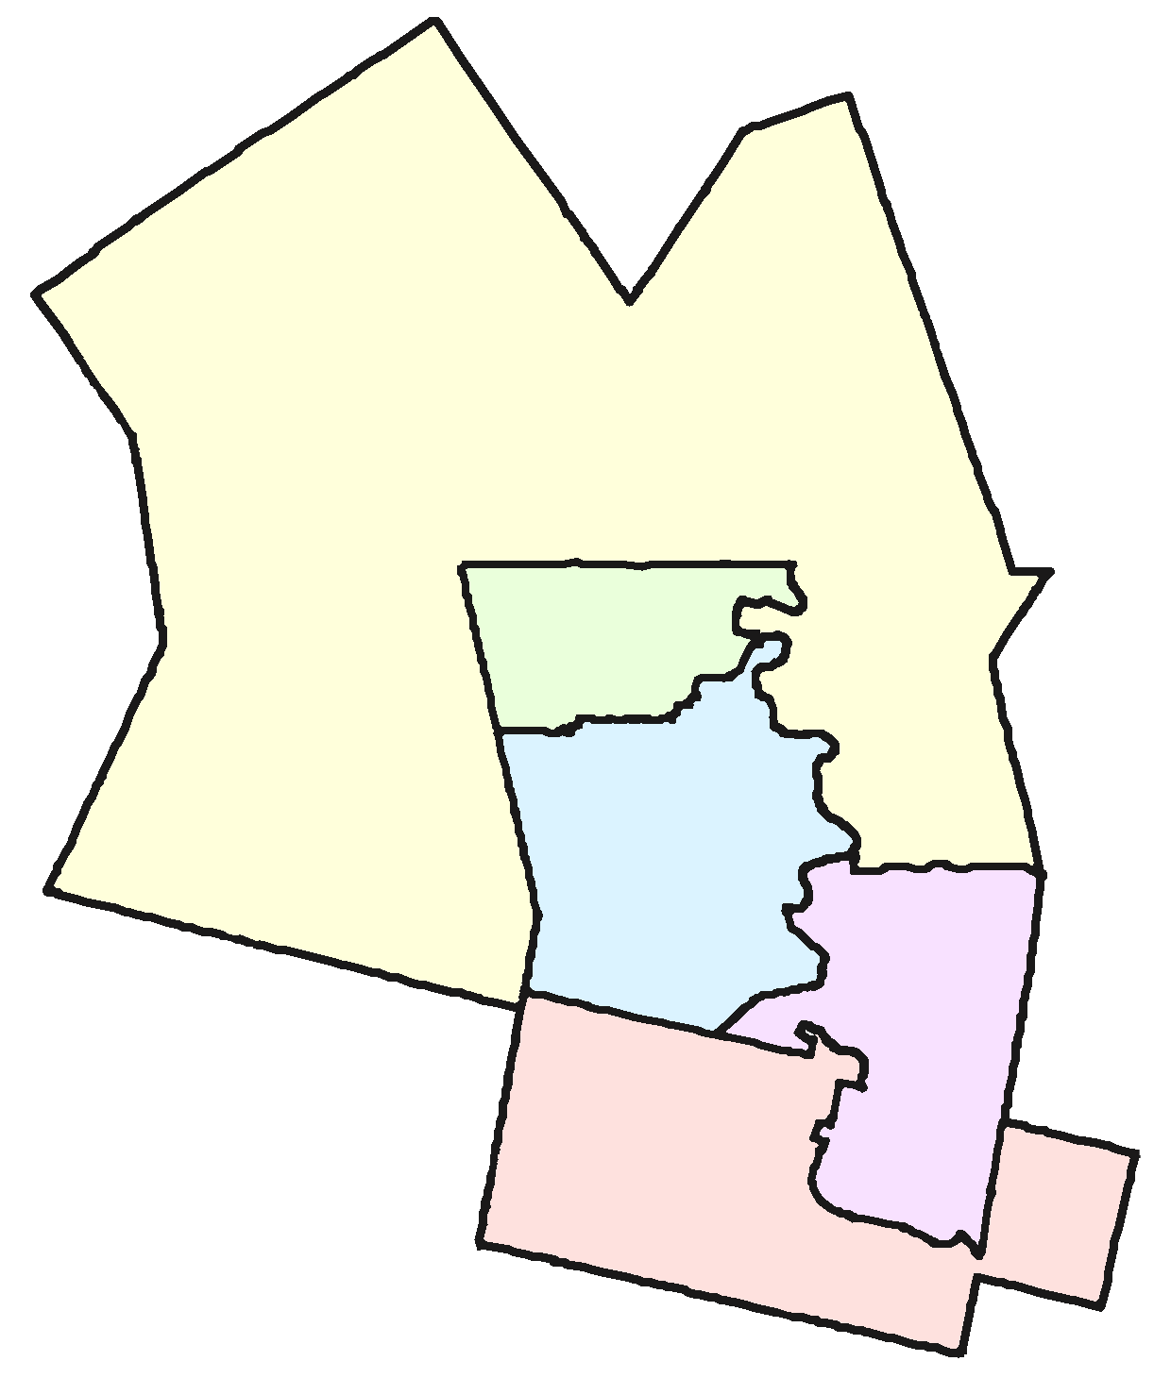
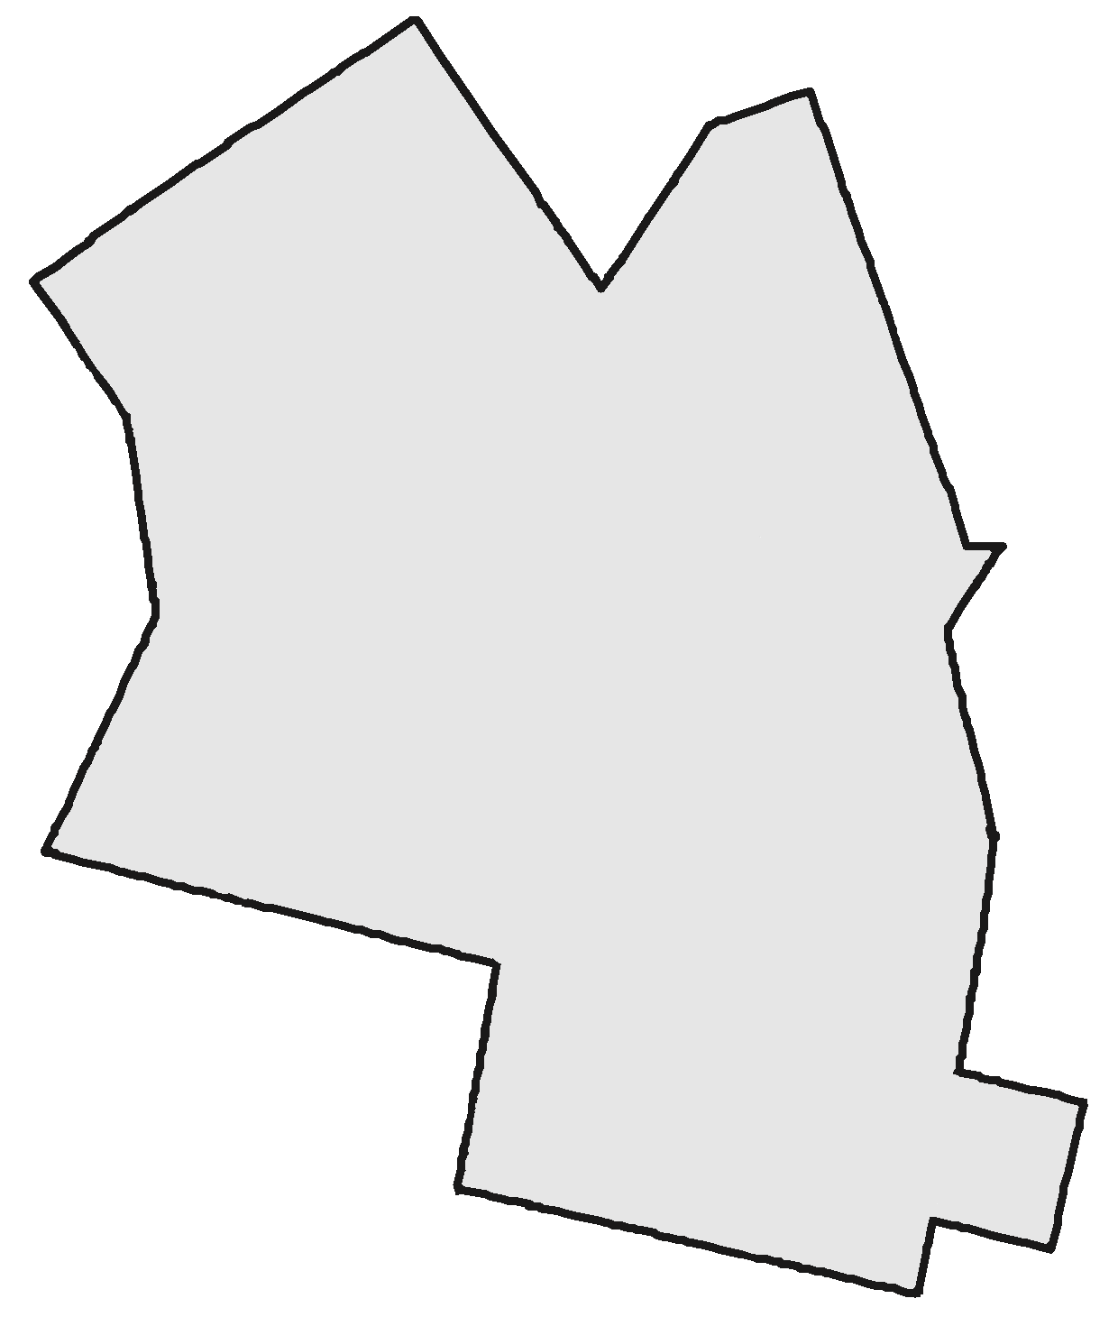
Multi-Member Systems
Combine several ridings into one
Elect the same total number of MPs
Example: Waterloo Region (Waterloo, Kitchener Centre, Kitchener-South Hespeler, Kitchener-Conestoga, Cambridge)
Notes:
The core idea of the Multi-Member systems is combining several ridings into one but electing the same number of MPs. Thus one riding will have multiple members of parliament representing it.
[Click] Let’s take Waterloo Region as an example. The Region is made up of five ridings that would be combined into a single riding.
[Click] In the 2015 election, these five ridings elected four Liberals and a Conservative. The question is, [Click] how would we elect five MPs if we could do it as a group rather than each one individually, as in first-past-the-post.

Slide 32
Multi-Member Systems
Notes:
[Click] We commented earlier how unfair first-past-the-post was on the national scale with the Liberals gaining 54% of the seats with less than 40% of the vote.
In Waterloo Region it was much worse. The Liberals gained 80% of the seats with only 46% of the vote.
This came, of course, at the expense of the Conservatives, NDP, and Greens.

Slide 33
Multi-Member Systems
Notes:
[Click] We would be much closer to proportional if we had elected 2 Conservatives, 2 Liberals, and an NDP. It’s not perfectly proportional, but it’s much closer.
The question is, how do we count our votes to arrive at this more-or-less proportional result?

Slide 34
Multi-Member Systems
Many ways to fairly elect five winners. (Closed List)
Conservative
  Charles Cooper
  Carrie Cohn
  Caleb Chong
Green
  Gary Gronau
  Greta Gill
Liberal
  Lily Laverty
  Logan Long
  Lisa Lawson
New Democrats
  Norman Nabers
  Nicole Noble
  Nina Nunn

Slide 35
Multi-Member Systems
Many ways to fairly elect five winners. (Open List)
Conservative
  Charles Cooper (13%)
  Carrie Cohn (12%)
  Caleb Chong (11%)
Green
  Gary Gronau (3%)
  Greta Gill (1%)
Liberal
  Lily Laverty (30%)
  Logan Long (10%)
  Lisa Lawson (6%)
New Democrats
  Norman Nabers (8%)
  Nina Nunn (4%)
  Nicole Noble (2%)
Notes:
Mark your favourite candidate.
List is ranked within parties in order by the number of votes received.
Take the top n candidates from each party’s list.

Slide 36
Multi-Member Systems
Many ways to fairly elect five winners. (Single Transferrable Vote)
Ballots are transferred to lower ranked candidates when it becomes obvious that the top-ranked candidate can’t win.
Top ballot:
Gary Gronau → Lily Laverty
Second ballot:
Nicole Noble → Nina Nunn → Logan Long
Third ballot:
Carrie Cohn
Notes:
Mark your favourite candidate.
List is ranked within parties in order by the number of votes received.
Take the top n candidates from each party’s list.

Slide 37
Types of Electoral Systems
Electoral Systems
Winner-Take-All Systems
Proportional
Systems
First-Past-The-Post
Alternative Vote
Multi-Member
Mixed Member
Rural-Urban Proportional
Notes:
[Click] The first thing to know is that there are many different electoral systems. They break down into two main families,
[Click] winner-take-all, and [Click] proportional systems.
In the winner-take-all family the most prominent system is known as [Click] first-past-the-post. It’s what Canada uses now.
Another winner-take-all-system that has received attention recently is known as [Click] alternative vote. It’s also known as instant run-off voting. There are other winner-take-all systems, as indicated by these extra boxes.
In the proportional family of electoral systems, [Click] one group is multi-member systems and the other is [Click] mixed member systems.
Again, there are many variations on these systems. We’ll look at one representative from each group.
=============== BACKGROUND
The first family is Majoritarian systems (like we have now) that elect a single person for each riding and each election is completely independent of all the others. First-Past-The-Post or FPTP is what Canada uses now. A variation of that system, Alternative Vote, is often talked about as an improvement on FPTP. Fair Vote believes that any proportional system is far better than any majoritarian system, including the Alternative Vote.
The second family of voting systems is Proportional Systems. There are at least two clans within this family. We’ll take a look at a representative member of each clan.
Alternative Vote is stacked in the graphic because there are a bunch of ways to count a ranked ballot. For example:
Successively dropping the candidate with the fewest first-place votes (AV)
Successively dropping the candidate with the most last-place votes
Ranked pairs (a version of Condorcet)
Borda count
Approval voting
Etc
However, these all elect a single person to represent the whole riding – and are thus not that different from FPTP. Almost everything in this list is better than AV, but not by much.
Similarly, Multi-Member and Mixed Member are stacked because there are also many variations on what we present here.
It’s worth stressing that there are many ways to do PR and that we can tailor a system to Canada.

Slide 38
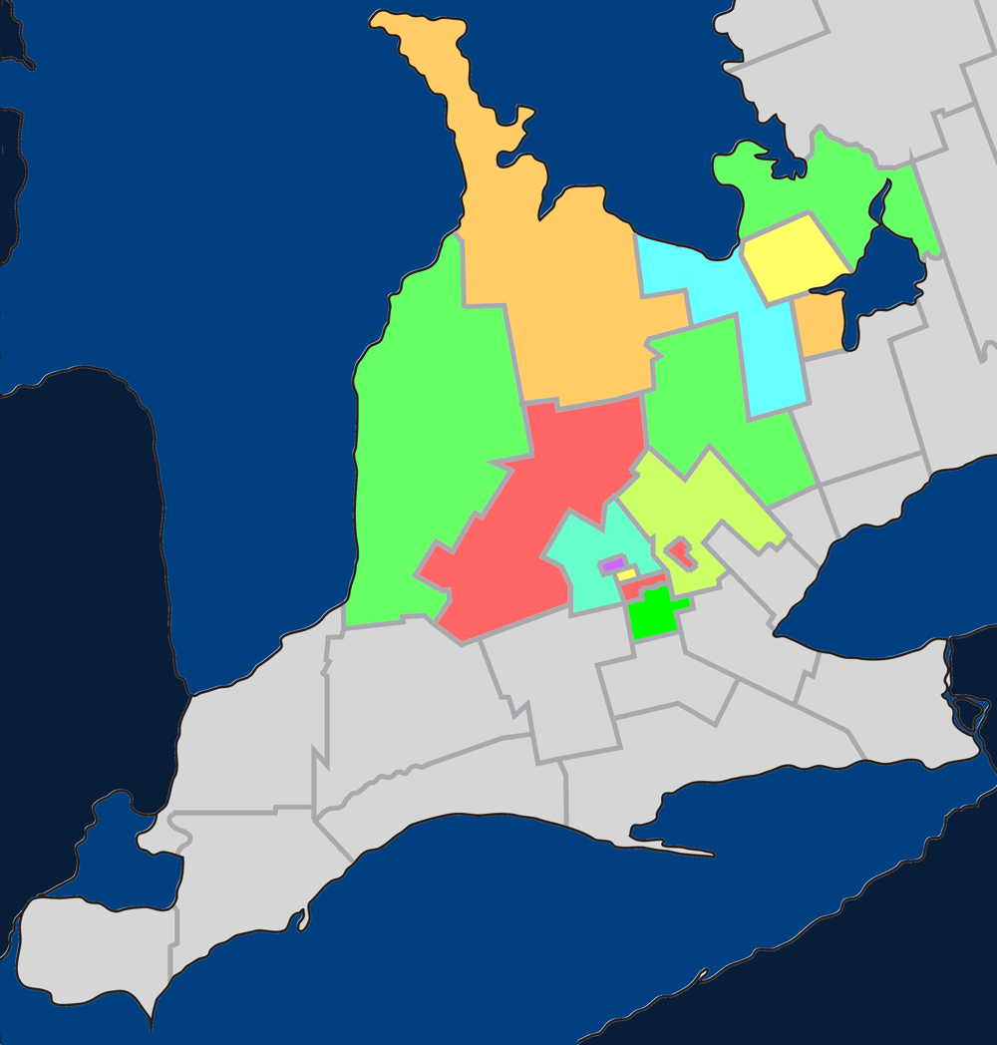
Mixed Member Proportional
Single-member
ridings in a multi-
member region
Example: Southern
Ontario
Notes:
Mixed Member Proportional system borrows ideas from our current first-past-the-post approach and from multi-member systems.
[Click] It does this by having single-member ridings within a multi-member region.
[Click] To understand what that means, let’s look at Southern Ontario as an example. [Click] In particular, we’ll look at a region with 15 ridings.

Slide 39
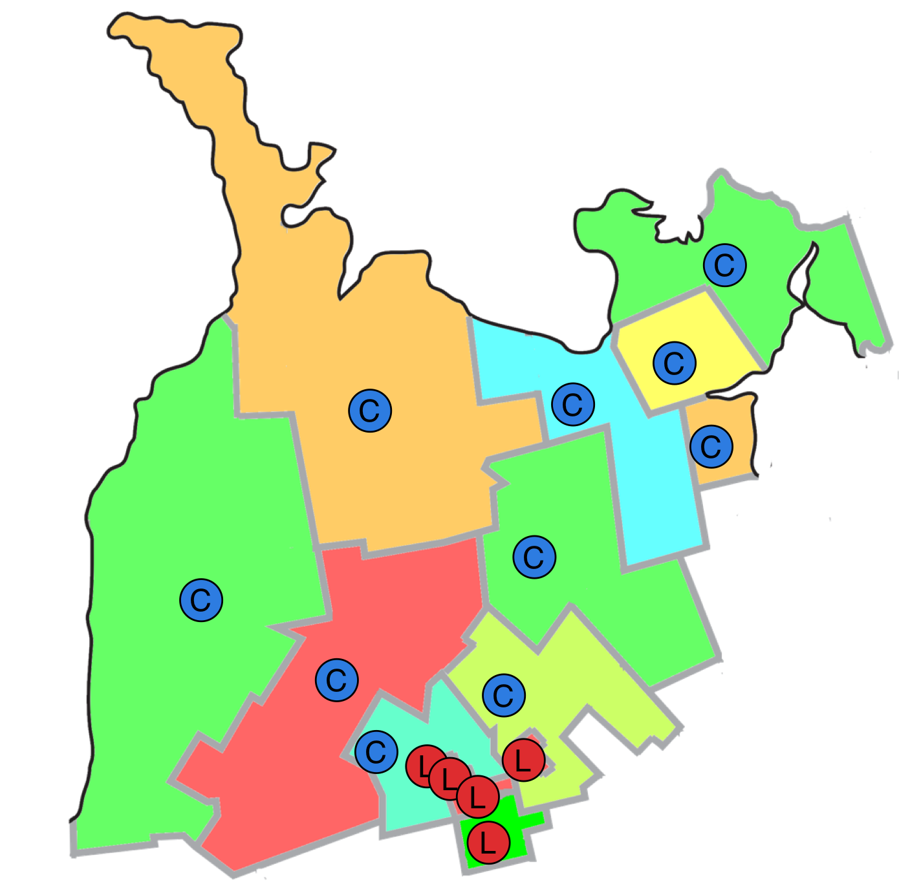
Mixed Member Proportional
Single-member
ridings in a multi-
member region
Example: Southern
Ontario
Notes:
[Click] We know how things went in these 15 ridings in the 2015 Federal Election: 5 went to Liberal candidates, 10 to Conservative candidates, and none to any of the other parties.

Slide 40

Mixed Member Proportional
Notes:
[Click] This makes the local results much more skewed than the nation as a whole. Within this region Liberals earned 42% of the votes – just a hair more than the Conservatives – and yet the Conservatives received twice as many seats in Parliament.

Slide 41
Mixed-Member Proportional
Single-member ridings in a multi-member region
15 MPs
  10 in single-member ridings
  5 in the region-at-large
  Regional MPs are chosen to ensure proportionality
Notes:
[Click] Mixed Member Proportional addresses this by continuing to have 15 MPs, but 10 of them would be in single-member ridings and 5 of them would be for the region at large. The Regional MPs are chosen to ensure overall proportionality with the popular vote.

Slide 42
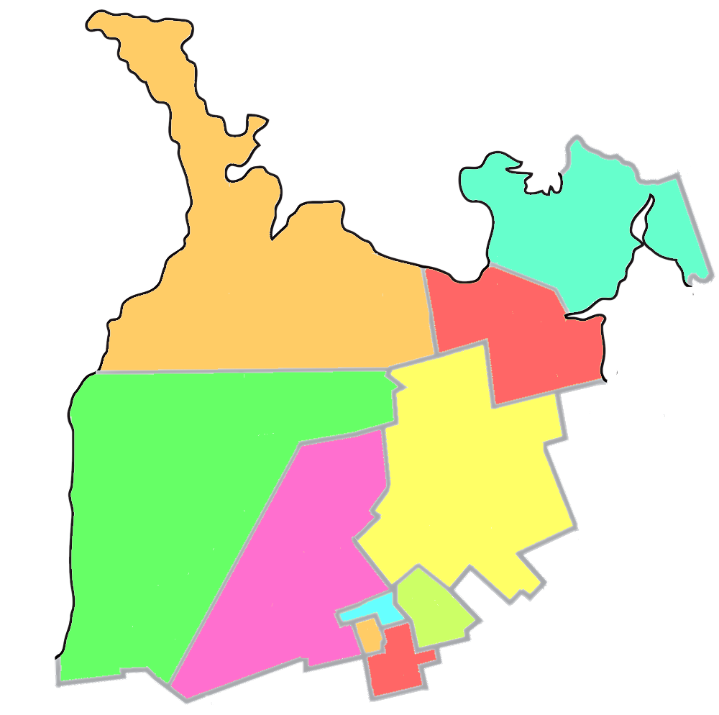

Mixed-Member Proportional
Notes:
[Click] This means that each riding becomes half again as large. Here’s how the region might be redistributed from 15 ridings into 10 ridings.
[Click] We could guess that these 10 ridings would have elected six Conservative MPs and four Liberal MPs in the last election. Each of those would have been elected using first-past-the-post, our current system.
[Click] The question is, how do we elect the remaining five MPs?

Slide 43
Mixed Member Proportional
Notes:
[Click] If we were to allocate the 15 seats proportionally, we’d give 6 to the Liberals and 6 to the Conservatives. The NDP would have 2 and the Greens 1.
[Click] Here’s how we think the riding seats would have been allocated; but how about the five regional seats?
[Click] Recall that they are chosen to maintain the overall proportionality between MPs and the popular vote.
[Click] Because the Conservatives received 6 riding seats, they don’t get any regional seats. They already have their fair share. The Liberals and NDP, however, each receive two regional seats while the Greens receive 1.

Slide 44
Mixed Member Proportional
Everyone has two votes:
  Local riding
  Party Proportionality
Notes:
[Click] That’s the goal – but how do we achieve it?
Everyone has two votes.
[Click] The first vote is for the MP to represent your riding. That vote would be just like now -- you vote for one person; whoever receives the most votes in your riding becomes your MP.
[Click] The second vote is for the party you prefer. This is the vote that’s used to calculate the proportional results – how many MPs each party should have for the region.

Slide 45
Filling regional seats
Make an ordered list for each party of all the candidates
Remove candidates that won a local seat
Take as many candidates as needed from the top of each party’s list to make results proportional
Ordering the lists:
  Closed List: Parties do it
  Open List: Voters do it
  List-Free: Remaining candidates with most votes
Conserv.
  Cohn
  Cooper
  Chong
  Chae
  Ceniza
  Cathers
  Cimino
  Church
  Clarke
  Classen
  Cizmarov
Liberal
  Long
  Laverty
  Lawson
  Lapp
  Laroque
  Leis
  Leferink
  Linton
  Lind
  Lynn
  Lukic
NDP
  Nabers
  Noble
  Nunn
  Nikolic
  Nguyen
  Nickel
  Ng
  Nabbi
  Near
  Nazar
  Nutt
Conserv.
  Cohn
  Cooper
  Chong
  Chae
  Ceniza
  Cathers
  Cimino
  Church
  Clarke
  Classen
  Cizmarov
Liberal
  Long
  Laverty
  Lawson
  Lapp
  Laroque
  Leis
  Leferink
  Linton
  Lind
  Lynn
  Lukic
NDP
  Nabers
  Noble
  Nunn
  Nikolic
  Nguyen
  Nickel
  Ng
  Nabbi
  Near
  Nazar
  Nutt
Conserv.
  Cohn
  Cooper
  Chong
  Chae
  Ceniza
  Cathers
  Cimino
  Church
  Clarke
  Classen
  Cizmarov
Liberal
  Long
  Laverty
  Lawson
  Lapp
  Laroque
  Leis
  Leferink
  Linton
  Lind
  Lynn
  Lukic
NDP
  Nabers
  Noble
  Nunn
  Nikolic
  Nguyen
  Nickel
  Ng
  Nabbi
  Near
  Nazar
  Nutt
Notes:
This text hasn’t been updated to match the slide.

Slide 46
Types of Electoral Systems
Electoral Systems
Winner-Take-All Systems
Proportional
Systems
First-Past-The-Post
Alternative Vote
Multi-Member
Mixed Member
Rural-Urban Proportional
Notes:
[Click] The first thing to know is that there are many different electoral systems. They break down into two main families,
[Click] winner-take-all, and [Click] proportional systems.
In the winner-take-all family the most prominent system is known as [Click] first-past-the-post. It’s what Canada uses now.
Another winner-take-all-system that has received attention recently is known as [Click] alternative vote. It’s also known as instant run-off voting. There are other winner-take-all systems, as indicated by these extra boxes.
In the proportional family of electoral systems, [Click] one group is multi-member systems and the other is [Click] mixed member systems.
Again, there are many variations on these systems. We’ll look at one representative from each group.
=============== BACKGROUND
The first family is Majoritarian systems (like we have now) that elect a single person for each riding and each election is completely independent of all the others. First-Past-The-Post or FPTP is what Canada uses now. A variation of that system, Alternative Vote, is often talked about as an improvement on FPTP. Fair Vote believes that any proportional system is far better than any majoritarian system, including the Alternative Vote.
The second family of voting systems is Proportional Systems. There are at least two clans within this family. We’ll take a look at a representative member of each clan.
Alternative Vote is stacked in the graphic because there are a bunch of ways to count a ranked ballot. For example:
Successively dropping the candidate with the fewest first-place votes (AV)
Successively dropping the candidate with the most last-place votes
Ranked pairs (a version of Condorcet)
Borda count
Approval voting
Etc
However, these all elect a single person to represent the whole riding – and are thus not that different from FPTP. Almost everything in this list is better than AV, but not by much.
Similarly, Multi-Member and Mixed Member are stacked because there are also many variations on what we present here.
It’s worth stressing that there are many ways to do PR and that we can tailor a system to Canada.

Slide 47
Rural-Urban PR
Made-in-Canada solution
Excellent proportionality
Address huge differences in riding sizes
  10km² up to 2,000,000km²
Combines features of Multi-Member and Mixed-Member
Use Alberta as an example

Slide 48
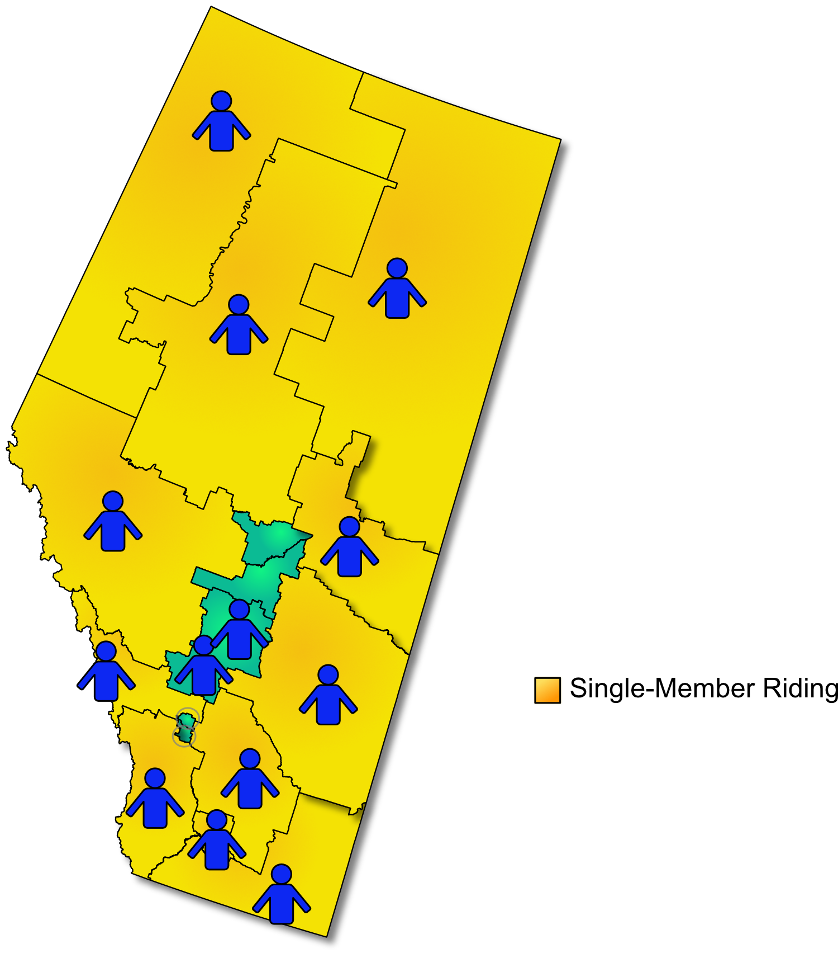
Rural-Urban PR
Step 1: Leave large ridings as single-member

Slide 49
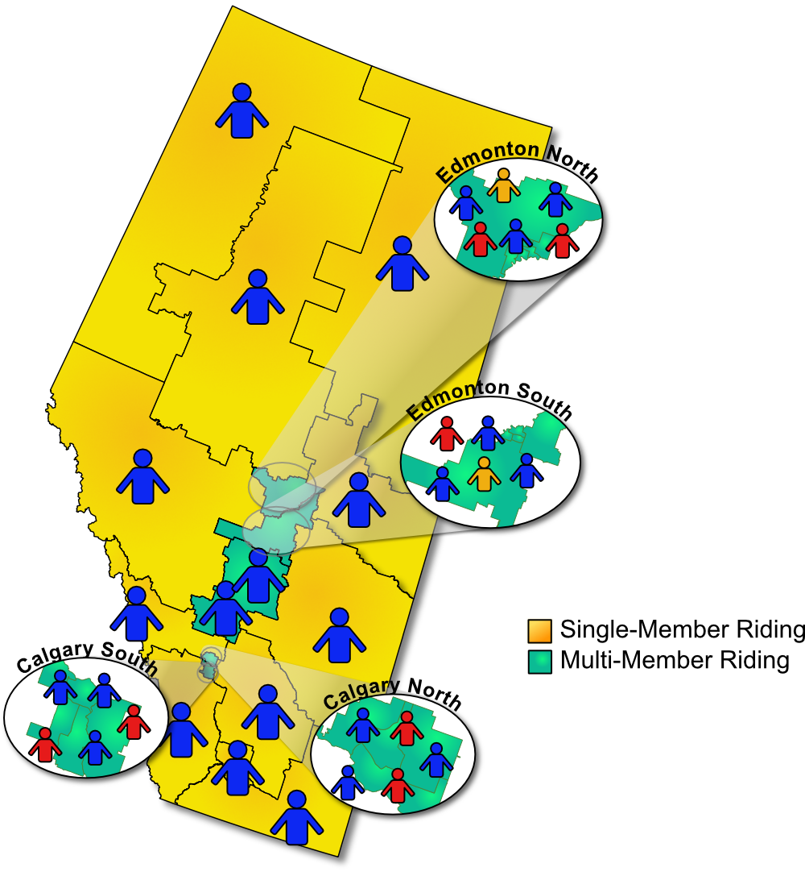
Rural-Urban PR
Step 1: Leave large ridings as single-member
Step 2: Combine densely populated areas into multi-member ridings

Slide 50
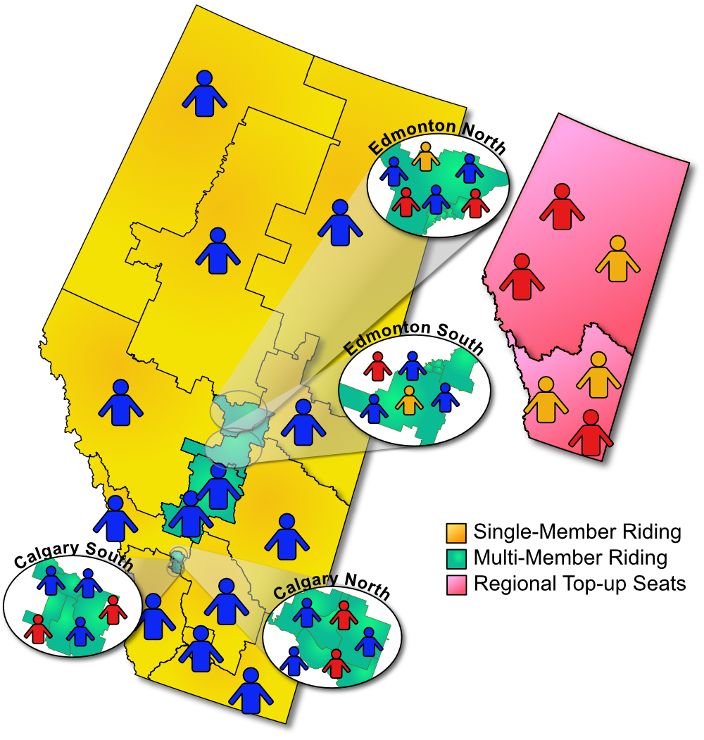
Rural-Urban PR
Step 1: Leave large ridings as single-member
Step 2: Combine densely populated areas into multi-member ridings
Step 3: Add top-up seats (like MMP)

Slide 51
Rural-Urban PR
Made-in-Canada solution
Excellent proportionality
Address huge differences in riding sizes
Dense ridings have ad-vantages of multi-member
Fewer top-up seats than MMP (feasible to just enlarge Parliament by 15%)
Smaller ridings than Multi-Member Systems

Slide 52
Value | Definition | Winner Take All | Propor-tional
Effectiveness & Legitimacy | fairly translate votes into representatives | ✗ | ✔
Engagement | encourage voting foster greater civility and collaboration enhance social cohesion include underrepresented groups | ✗ ✗ ✗ ✗ | ✔ ✔ ✔ ✔
Accessibility & Inclusiveness | avoid undue voting complexity while respecting other principles | ✔ ✗ | ? ✔
Integrity | safeguard trust in the election process give reliable and verifiable results | ✔ ✔ | ✔ ✔
Local Representation | ensure accountable MPs ensure accessible (like-minded) MPs MPs understand local conditions & advance local needs | ✔ ✗ ? | ✔ ✔ ?
Good Governance | yield stable governments governments that enact long-lasting policies supported by the majority of voters | ✔ ✗ | ✔ ✔
Notes:
Fairly translate votes: With FPTP a party can get 100% of the power with only 40% of the votes. In proportional systems, each party’s proportion of power matches their proportion of the seats.
Encourage voting: With majoritarian systems, many of our votes don’t affect the outcome of the election and some of us have never helped elect a winning candidate. In proportional systems our votes count, which encourages people to vote. Democracies using proportional systems typically have voter turnout rates of 7-8% higher than ours.
Foster greater civility and collaboration: When parties can get 100% of the power with only 40% of the vote, there is tremendous incentive to trash talk the other parties in hopes of short-term gain. With proportional systems, that short-term gain simply isn’t there. Parties have to learn to work together.
Enhance Social cohesion: Our current system magnifies regional differences. Alberta looks more conservative than it really is. Toronto looks more Liberal. PR represents our country as it really is, which I believe is more cohesive than it feels under FPTP.
Include underrepresented groups: Internationally, we observe that majoritarian countries elect far fewer women than PR countries. If we adopted PR, we could expect the number of women in parliament to rise, along with members of various minority groups.
Voting complexity: FPTP is about as easy as it gets – but that simplicity comes at the cost of unfair elections, reduced representation of women and other groups, and many other ill effects. Some forms of PR are just as simple for the voter as FPTP. All of them have been mastered by the citizens of other countries and can be mastered by Canadians as well.
Integrity: All of these systems can be implemented to safeguard the integrity of the election process.
Accountable MPs: All of the systems have MPs that face the voters and can be thrown out if not doing a good job.
Accessible MPs: In our current system, every voter has an MP they can go to but there is no assurance that MP is like-minded enough to understand the voter’s perspective. In proportional systems most voters are represented by an MP with a similar world view.
Local conditions: Like the previous point, winner-take-all systems elect MPs that have one particular view of local conditions and needs but may not really understand the views of half of their constituents. So I’ve given winner-tak—all systems a question mark. PR systems have multiple people representing a local area, but they are also less local and so perhaps don’t understand the issues quite as well.
Stable governments: International comparisons indicate both systems yield stable governments.
Long-lasting policies: However, winner-take-all systems suffer from policy lurch where a government with a false majority implements policies that are not truly supported by a majority. When they are eventually swept from power their policies are often reversed by the next government. This makes planning for businesses, public institutions, and even families hard. PR, on the other hand, tends to be much more collaborative with longer-lasting policies.

Slide 53
Summary
Proportional electoral systems satisfy our criteria much better than majoritarian systems like FPTP and Alternative Vote.
The exception is simplicity
  Voters in many other countries have figured it out
  Voting is not that much more complex; counting the vote is the responsibility of Elections Canada
There are different kinds of PR – with real differences – but ANY form of PR meets the established criteria better than FPTP or AV.
Notes:
This text hasn’t been updated to match the slide.
[Click] To summarize,
[Click] Our current system often gives results that are very different from the popular vote. Less than 40% of Canadian voters voted for the Liberals in the 2015 election or the Conservatives in the 2011 election. Yet in both cases they received a majority in parliament and 100% of the power.
[Click] By over-representing some voices, other voices are necessarily diminished, limiting the diversity that research shows is important for good decision-making.
[Click] The Alternative Vote has been promoted as a remedy with the flawed reasoning that a manufactured consensus is good enough. But in practise, it gives the same results as first-past-the-post without solving any of its problems.
[Click] Finally, in winner-take-all systems the votes for losing candidates are ignored and have no influence on the direction of the country. That is, many votes simply don’t count. Lots of business-oriented research shows that a group of diverse-thinking people make better decisions that a more homogenous group. See, for example, http://www.scientificamerican.com/article/how-diversity-makes-us-smarter/

Slide 54
Questions
&
Responses

Slide 55

More Information
Electoral Reform Committee
http://www.parl.gc.ca/Committees/en/ERRE
Fair Vote Canada:
https://fairvote.ca
Waterloo Region Fair Vote:
http://www.fairvotewrc.ca/
Questionaire (results sent
to local MPs):
http://tinyurl.com/jpcga9g
Notes:
MMP Video: www.youtube.com/watch?v=D3guVBhKmDc
STV video: www.youtube.com/watch?v=bLH_w5kHJpA
Evidence Summary: docs.google.com/document/d/1YfCj0cx4XDqJDDwFV9kRoRDyHxJ2azxuny6EQjwu6v8/edit?usp=sharing
Recent Research: docs.google.com/document/d/1_86RnPYohC3dkuihEZXrP82s5AP6kO5jE-DMW7_S7uw/edit?usp=sharing
[Perhaps show this slide as soon as questions have started. ]

Slide 56
Acknowledgements
Author: Byron Weber Becker
Research, editorial advice, project management: Sharon Sommerville, Bob Jonkman, Sean Haberlin, Gordon Divitt, Holly Featherstone, and many other members of Fair Vote Waterloo Region
To the extent possible under law, Byron Weber Becker has waived all copyright and related or neighboring rights to this Presentation. This work is published from: Canada.
See http://creativecommons.org/publicdomain/zero/1.0/

Slide 58
Appendices
Stuff that might be useful for some audiences.
Notes:
The slides that follow might be useful for more technical audiences or to answer some questions.

Slide 59
Elections should…
Value | Definition | AV
Effectiveness & Legitimacy | fairly translate votes into the election of representatives, without distortion. | ✗
Engagement | encourage voting, foster greater civility and collaboration in politics, enhance social cohesion, and include underrepresented groups. | ? ?✗✗
Accessibility & Inclusiveness | avoid undue voting complexity while respecting other principles; provide access by voters regardless of physical or social condition. | ✗✗✔
Local Representation | ensure accountability with accessible MPs that understand local conditions & advance local needs | ✔✔?
Good Governance | yield stable governments enacting long-lasting policies supported by the majority of voters | ✔ ✗
Notes:
Effectiveness: Distorts the results. Many people get their 3rd or 4th choices
Engagement: People supporting anyone except the locally dominant parties don’t have much reason to vote. Undermines social cohesion because it makes regions appear more Conservative or Liberal or separatist than they really are. Does not do a good job of including underrepresented groups such as women.
Accessibility: Increases the complexity but doesn’t do any better on the other principles.
Local Rep: Accountable in that voters can kick an individual MP out – but it rarely happens unless they are really trying to kick the party out. Understands local connections but through a filter that most of the people in the riding don’t share. Advances local needs, but again with a filter that half the riding may not share.
Governance: False majorities often mean that policies are not supported by a majority of the population.

Slide 60
FPTP Instability
100 Voters
40 Liberal
35 Conservative
25 NDP
Variations in voter distribution give the “right” results (sometimes).
Notes:
This group of three slides illustrate how arbitrary FPTP can be. It assumes the same election – 100 voters distributed between three parties – and shows how the outcome depends completely on how those voters are distributed between the ridings.
In this slide the voters are distributed more-or-less randomly between the ridings nd the election comes out basically as it should – two Liberals, two Conservatives, and a New Democrat. That’s close to proportional.

Slide 61
FPTP Instability
100 Voters
40 Liberal
35 Conservative
25 NDP
Perfectly even voter distributions give every riding to the same party.
Notes:
But if the voters are distributed perfectly evenly across the five ridings, the result is a Liberal sweep!

Slide 62
FPTP Instability
100 Voters
40 Liberal
35 Conservative
25 NDP
Uneven voter distributions can give skewed or wrong results.
Notes:
But if it’s only the Liberals that are evenly distributed, they can get completely shut out – in spite of having the most votes!
I (Byron, the author) think this instability makes FPTP completely unsuitable as an election mechanism. By “instability” I mean that the results depend on completely arbitrary factors like how the voters are distributed around the country.

Slide 63
Wrong Winner Alternative Vote
Con 38%
(NDP 3%, Lib 35%)
NDP 29%
(Con 4%, Lib 25%)
Lib 26%
(Con 10%, NDP 10%, Grn 6%)
Grn 5%
(Lib 4%, NDP 1%)
Ind 2%
(NDP 2%)
2%
Con 38%
NDP 31%
Lib 26%
Grn 5%
1%
1st or 2nd:
Lib 90%
Con 52%
NDP 45%
Grn 11%
Ind 2%
4%
Con 38%
NDP 32%
Lib 30%
10% + ???
10% + ???
Con
48+???%
NDP 42+???%
Notes:
This is another version of an Alternative Vote election. This time the voters’ 2nd place preferences are also listed. For example, 38% list the Conservative as their first choice. The little numbers underneath mean that 3% list the NDP as their second choice and 35% list Liberal as their 2nd choice. Similarly for the other parties.
Pause for a good while on the second click that shows the box in the lower right corner. It shows that 90% of the people list the Liberals as their first or second choice. That is far higher than any of the other parties. If we’re looking for a consensus candidate – which is what AV is supposed to do – the Liberal candidate should be it.
But, as the vote counting unfolds, we see that the Liberals are dropped out before either the NDP or the Conservative with the result that one of them (we’re not sure which because we didn’t record third place votes) wins.
But it should have been the Liberal!
That said, in general AV favours the centrist candidate – which is why many Conservatives and New Democrats have been vocal in the media against AV and accused the Liberals of wanting to bring it in.

Slide 64
Common Questions
Are PR governments less stable than FPTP?
  Common examples are Italy and Israel. But they use forms of PR that no one has suggested for Canada.
  FPTP countries averaged 16.7 elections between 1945 and 1998; PR countries averaged 16.0 elections.
Is PR is too complicated?
  Voting: a little more complicated than now
  Counting: professionals at Elections Canada can handle it
Do small, single-issue parties have too much power?
  3-5% threshold before given top-up seats

Slide 65
Is a referendum needed?
Canada is a representative democracy
  Choose representatives to study issues on our behalf and make decisions
  Well-suited to complex decisions
Canada hardly ever uses referendums
  1898 (Prohibition), 1942 (Conscription), 1992 (Charlottetown Accord)
  Provincial referendums are also rare
Many electoral changes have been made without a referendum
  Eg: replace oral votes with secret ballots (1874), removal of property and income restrictions (early 1900’s), giving women the vote (universally) (1918), etc.
Notes:
If someone wants to talk about holding a referendum…

Slide 66
Referendums
Many changes to elections in Canada without referendums
  1874: Move from oral votes to secret ballots, all constituencies vote on the same day
  1885: Defining elector qualifications becomes federal responsibility
  Early 1900’s: removal of property and income restrictions
  1918: Women allowed to vote
  1948: Racial discrimination ends (except First Nations)
  1960: All status Indians allowed to vote
  1982: Charter guarantees voting rights to all citizens
Notes:
Source: http://www.elections.ca/content.aspx?section=res&dir=his&document=index&lang=e (A History of the Vote in Canada)

Slide 67
Do we want a referendum?
Referendums are not good ways to decide complex questions.
If used, referendums need a clear, simple question:
  Choose one:
  __ I support changing to a proportional system of voting
  (each party’s share of seats in Parliament is about the
  same as their share of the popular vote)
  __ I support continuing with our current system of voting
  (in each riding, the candidate with the most votes wins
  and all others lose)
Best: Referendum after the new system is used twice
Notes:
New Zealand had a referendum asking if people wanted to change, in principle. They did. Introduced a new system and used it twice. Then held another referendum to ask if they wanted to keep it. They did. [The actual history is more complex with a few shinanigans, but this is it in a nutshell.]

