Slide 1

Make every vote count with Mixed-Member Systems
Notes:
Note: The speaker’s notes have not been kept up to date with the slides.

Slide 2
Outline
What are appropriate electoral reform principles?
Which electoral systems are other countries using?
How do Mixed-Member systems work?
Do these systems deliver on the principles?
Questions and Responses
Where to find more information
Notes:
[Click] The outline for the presentation is to:
[Click] talk more about the criteria by which we might evaluate parliament
[Click] look at the systems other countries are using
[Click] explore how those systems work
[Click] ask whether they deliver the kind of parliament Canadians want
We’ll close with a brief summary and a time for questions. Questions of clarification are also welcome as we go along.

Slide 3
Parliamentary Committee’s Electoral Reform Principles
1) Effectiveness and legitimacy: that the proposed measure would increase public confidence among Canadians that their democratic will, as expressed by their votes, will be fairly translated and that the proposed measure reduces distortion and strengthens the link between voter intention and the election of representatives;
2) Engagement: that the proposed measure would encourage voting and participation in the democratic process, foster greater civility and collaboration in politics, enhance social cohesion and offer opportunities for inclusion of underrepresented groups in the political process;
3) Accessibility and inclusiveness: that the proposed measure would avoid undue complexity in the voting process, while respecting the other principles, and that it would support access by all eligible voters regardless of physical or social condition;
4) Integrity: that the proposed measure can be implemented while safeguarding public trust in the election process, by ensuring reliable and verifiable results obtained through an effective and objective process that is secure and preserves vote secrecy for individual Canadians;
5) Local representation: that the proposed measure would ensure accountability and recognize the value that Canadians attach to community, to Members of Parliament understanding local conditions and advancing local needs at the national level, and to having access to Members of Parliament to facilitate resolution of their concerns and participation in the democratic process;
Notes:
[Click] The committee’s recommendations are supposed to respect five core principles. Now, this is a lot of text, so I’ve summarized on the next slides.

Slide 4
Value | Definition
Effectiveness & Legitimacy | fairly translate votes into representatives
Engagement
Accessibility & Inclusiveness
Integrity
Local Representation
Notes:
So there’s the list of criteria.
In a few moments we’ll start looking at a number of ways to run elections. For each one, we want to come back to look at this list and ask how it rates.

Slide 5
Value | Definition
Effectiveness & Legitimacy | fairly translate votes into representatives
Engagement | encourage voting foster greater civility and collaboration in politics enhance social cohesion include underrepresented groups
Accessibility & Inclusiveness
Integrity
Local Representation
Notes:
So there’s the list of criteria.
In a few moments we’ll start looking at a number of ways to run elections. For each one, we want to come back to look at this list and ask how it rates.

Slide 6
Value | Definition
Effectiveness & Legitimacy | fairly translate votes into representatives
Engagement | encourage voting foster greater civility and collaboration in politics enhance social cohesion include underrepresented groups
Accessibility & Inclusiveness | avoid undue voting complexity while respecting other principles
Integrity
Local Representation
Notes:
So there’s the list of criteria.
In a few moments we’ll start looking at a number of ways to run elections. For each one, we want to come back to look at this list and ask how it rates.

Slide 7
Value | Definition
Effectiveness & Legitimacy | fairly translate votes into representatives
Engagement | encourage voting foster greater civility and collaboration in politics enhance social cohesion include underrepresented groups
Accessibility & Inclusiveness | avoid undue voting complexity while respecting other principles
Integrity | safeguard trust in the election process give reliable and verifiable results
Local Representation
Notes:
So there’s the list of criteria.
In a few moments we’ll start looking at a number of ways to run elections. For each one, we want to come back to look at this list and ask how it rates.

Slide 8
Value | Definition
Effectiveness & Legitimacy | fairly translate votes into representatives
Engagement | encourage voting foster greater civility and collaboration in politics enhance social cohesion include underrepresented groups
Accessibility & Inclusiveness | avoid undue voting complexity while respecting other principles
Integrity | safeguard trust in the election process give reliable and verifiable results
Local Representation | ensure accountable MPs ensure accessible MPs MPs understand local conditions & advance local needs
Notes:
So there’s the list of criteria.
In a few moments we’ll start looking at a number of ways to run elections. For each one, we want to come back to look at this list and ask how it rates.

Slide 9
Value | Definition
Effectiveness & Legitimacy | fairly translate votes into representatives
Engagement | encourage voting foster greater civility and collaboration in politics enhance social cohesion include underrepresented groups
Accessibility & Inclusiveness | avoid undue voting complexity while respecting other principles
Integrity | safeguard trust in the election process give reliable and verifiable results
Local Representation | ensure accountable MPs ensure accessible MPs MPs understand local conditions & advance local needs
Good Governance | yield stable governments governments that enact long-lasting policies supported by the majority of voters
Notes:
So there’s the list of criteria.
In a few moments we’ll start looking at a number of ways to run elections. For each one, we want to come back to look at this list and ask how it rates.

Slide 10
Value | Definition
Effectiveness & Legitimacy | fairly translate votes into representatives
Engagement | encourage voting foster greater civility and collaboration in politics enhance social cohesion include underrepresented groups
Accessibility & Inclusiveness | avoid undue voting complexity while respecting other principles
Integrity | safeguard trust in the election process give reliable and verifiable results
Local Representation | ensure accountable MPs ensure accessible MPs MPs understand local conditions & advance local needs
Good Governance | yield stable governments governments that enact long-lasting policies supported by the majority of voters
Notes:
So there’s the list of criteria.
In a few moments we’ll start looking at a number of ways to run elections. For each one, we want to come back to look at this list and ask how it rates.

Slide 11

Types of Electoral Systems
Electoral Systems
Winner-Take-All Systems
Proportional
Systems
First-Past-The-Post
Alternative Vote
Multi-Member
Mixed Member
Rural-Urban Proportional
Notes:
[Click] The first thing to know is that there are many different electoral systems. They break down into two main families,
[Click] winner-take-all, and [Click] proportional systems.
In the winner-take-all family the most prominent system is known as [Click] first-past-the-post. It’s what Canada uses now.
Another winner-take-all-system that has received attention recently is known as [Click] alternative vote. It’s also known as instant run-off voting. There are other winner-take-all systems, as indicated by these extra boxes.
In the proportional family of electoral systems, [Click] one group is multi-member systems and the other is [Click] mixed member systems.
Again, there are many variations on these systems. We’ll look at one representative from each group.
=============== BACKGROUND
The first family is Majoritarian systems (like we have now) that elect a single person for each riding and each election is completely independent of all the others. First-Past-The-Post or FPTP is what Canada uses now. A variation of that system, Alternative Vote, is often talked about as an improvement on FPTP. Fair Vote believes that any proportional system is far better than any majoritarian system, including the Alternative Vote.
The second family of voting systems is Proportional Systems. There are at least two clans within this family. We’ll take a look at a representative member of each clan.
Alternative Vote is stacked in the graphic because there are a bunch of ways to count a ranked ballot. For example:
Successively dropping the candidate with the fewest first-place votes (AV)
Successively dropping the candidate with the most last-place votes
Ranked pairs (a version of Condorcet)
Borda count
Approval voting
Etc
However, these all elect a single person to represent the whole riding – and are thus not that different from FPTP. Almost everything in this list is better than AV, but not by much.
Similarly, Multi-Member and Mixed Member are stacked because there are also many variations on what we present here.
It’s worth stressing that there are many ways to do PR and that we can tailor a system to Canada.

Slide 12
Who is Using What?
Winner-Take-All Systems:
First-Past-The-Post:
  United States
  Canada
  Singapore
  United Kingdom
Alternative Vote:
  Australia
Other:
  France, Bahrain, Belarus
Proportional Systems:
Multi-Member
  Norway
  Switzerland
  Denmark
  Netherlands
  Ireland
  Liechtenstein
  Sweden
  Iceland
  Israel
  Luxembourg
  Belgium
  Austria
  Finland
  Slovenia
  Spain
  Italy
  Czech Republic
  Greece
  Estonia
  Cyprus
  Slovakia
  Poland
  Malta
  Argentina
  United Arab Emirates
  Chile
  Portugal
  Latvia
  Croatia
  Kuwait
  Montenegro
Mixed Member
  Germany
  New Zealand
  Hungary
Parallel Systems
  South Korea
  Japan
  Andorra
  Lithuania
Looking at democracies scoring “very high” on the UN’s Human Development Index.
Notes:
[Click] But first, which countries are already using these systems?
For this comparison, we’re really interested in countries like Canada – similar in values, life style, and (of course) democracies. We’re using countries ranked “very high” on the United Nation’s Human Development index as a benchmark.
[Click] Let’s look first at countries using a Winner-Take-All system.
On the UN’s Human Development Index, there are four countries that use first-past-the-post. [Click] Canada, of course, the United States, Singapore and the United Kingdom. All four have close historical ties in the development of their democracies.
[Click] The only country on the list to use the Alternative Vote is Australia.
[Click] A couple use a two-round system that we won’t discuss.
[Click] On the other hand, here are all the countries on the UN list that use some form of proportional representation. Some of the prominent ones are New Zealand, Germany, and many other European countries.
[We have received gasps of surprise at this last one. Be sure to stay here long enough for it to sink in!]
[Click] Finally, there are a couple that use Parallel systems that mix winner-take-all and proportional.
==================
Notes: Within each group the countries are listed in HDI order.
How this list was created:
Take the countries ranked “very high” on the UN’s Human Development Index (http://www.nationsonline.org/oneworld/human_development.htm; actual list from https://en.wikipedia.org/wiki/List_of_countries_by_Human_Development_Index). Remove non-democracies like Saudia Arabia, UAE, Qatar, Cuba. Cross-reference that with http://www.idea.int/db/fieldview.cfm?field=154#tableTab1 to get the electoral system used.
There are lots of other countries that use FPTP, but they aren’t high on the UN’s Human Development Index – in other words most of us would not choose to live in those countries unless we had family or something there.
The Human Development Index (HDI) is a summary measure of average achievement in key dimensions of human development: (1) a long and healthy life, (2) being knowledgeable and (3) have a decent standard of living. (http://hdr.undp.org/en/content/human-development-index-

Slide 13
Value | Definition | Winner Take All | Propor-tional
Effectiveness & Legitimacy | fairly translate votes into representatives | ✗
Engagement | encourage voting foster greater civility and collaboration enhance social cohesion include underrepresented groups | ✗ ✗ ✗ ✗
Accessibility & Inclusiveness | avoid undue voting complexity while respecting other principles | ✔ ✗
Integrity | safeguard trust in the election process give reliable and verifiable results | ✔ ✔
Local Representation | ensure accountable MPs ensure accessible (like-minded) MPs MPs understand local conditions & advance local needs | ? ✗ ✔
Good Governance | yield stable governments governments that enact long-lasting policies supported by the majority of voters | ✔ ✗
Notes:
Fairly translate votes: With FPTP a party can get 100% of the power with only 40% of the votes. In proportional systems, each party’s proportion of power matches their proportion of the seats.
Encourage voting: With majoritarian systems, many of our votes don’t affect the outcome of the election and some of us have never helped elect a winning candidate. In proportional systems our votes count, which encourages people to vote. Democracies using proportional systems typically have voter turnout rates of 7-8% higher than ours.
Foster greater civility and collaboration: When parties can get 100% of the power with only 40% of the vote, there is tremendous incentive to trash talk the other parties in hopes of short-term gain. With proportional systems, that short-term gain simply isn’t there. Parties have to learn to work together.
Enhance Social cohesion: Our current system magnifies regional differences. Alberta looks more conservative than it really is. Toronto looks more Liberal. PR represents our country as it really is, which I believe is more cohesive than it feels under FPTP.
Include underrepresented groups: Internationally, we observe that majoritarian countries elect far fewer women than PR countries. If we adopted PR, we could expect the number of women in parliament to rise, along with members of various minority groups.
Voting complexity: FPTP is about as easy as it gets – but that simplicity comes at the cost of unfair elections, reduced representation of women and other groups, and many other ill effects. Some forms of PR are just as simple for the voter as FPTP. All of them have been mastered by the citizens of other countries and can be mastered by Canadians as well.
Integrity: All of these systems can be implemented to safeguard the integrity of the election process.
Accountable MPs: All of the systems have MPs that face the voters and can be thrown out if not doing a good job. But seats can be pretty safe under FPTP, making it hard to change the MP.
Accessible MPs: In our current system, every voter has an MP they can go to but there is no assurance that MP is like-minded enough to understand the voter’s perspective. In proportional systems most voters are represented by an MP with a similar world view.
Local conditions: Like the previous point, winner-take-all systems elect MPs that have one particular view of local conditions and needs but may not really understand the views of half of their constituents. So I’ve given winner-tak—all systems a question mark. PR systems have multiple people representing a local area, but they are also less local and so perhaps don’t understand the issues quite as well.
Stable governments: International comparisons indicate both systems yield stable governments.
Long-lasting policies: However, winner-take-all systems suffer from policy lurch where a government with a false majority implements policies that are not truly supported by a majority. When they are eventually swept from power their policies are often reversed by the next government. This makes planning for businesses, public institutions, and even families hard. PR, on the other hand, tends to be much more collaborative with longer-lasting policies.

Slide 14
Types of Electoral Systems
Electoral Systems
Winner-Take-All Systems
Proportional
Systems
First-Past-The-Post
Alternative Vote
Multi-Member
Mixed Member
Rural-Urban Proportional
Notes:
[Click] The first thing to know is that there are many different electoral systems. They break down into two main families,
[Click] winner-take-all, and [Click] proportional systems.
In the winner-take-all family the most prominent system is known as [Click] first-past-the-post. It’s what Canada uses now.
Another winner-take-all-system that has received attention recently is known as [Click] alternative vote. It’s also known as instant run-off voting. There are other winner-take-all systems, as indicated by these extra boxes.
In the proportional family of electoral systems, [Click] one group is multi-member systems and the other is [Click] mixed member systems.
Again, there are many variations on these systems. We’ll look at one representative from each group.
=============== BACKGROUND
The first family is Majoritarian systems (like we have now) that elect a single person for each riding and each election is completely independent of all the others. First-Past-The-Post or FPTP is what Canada uses now. A variation of that system, Alternative Vote, is often talked about as an improvement on FPTP. Fair Vote believes that any proportional system is far better than any majoritarian system, including the Alternative Vote.
The second family of voting systems is Proportional Systems. There are at least two clans within this family. We’ll take a look at a representative member of each clan.
Alternative Vote is stacked in the graphic because there are a bunch of ways to count a ranked ballot. For example:
Successively dropping the candidate with the fewest first-place votes (AV)
Successively dropping the candidate with the most last-place votes
Ranked pairs (a version of Condorcet)
Borda count
Approval voting
Etc
However, these all elect a single person to represent the whole riding – and are thus not that different from FPTP. Almost everything in this list is better than AV, but not by much.
Similarly, Multi-Member and Mixed Member are stacked because there are also many variations on what we present here.
It’s worth stressing that there are many ways to do PR and that we can tailor a system to Canada.

Slide 15
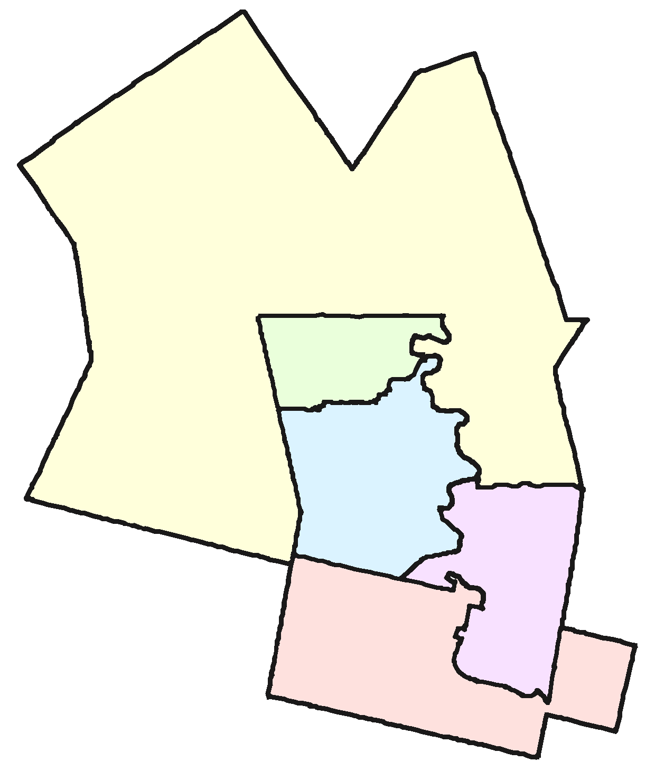
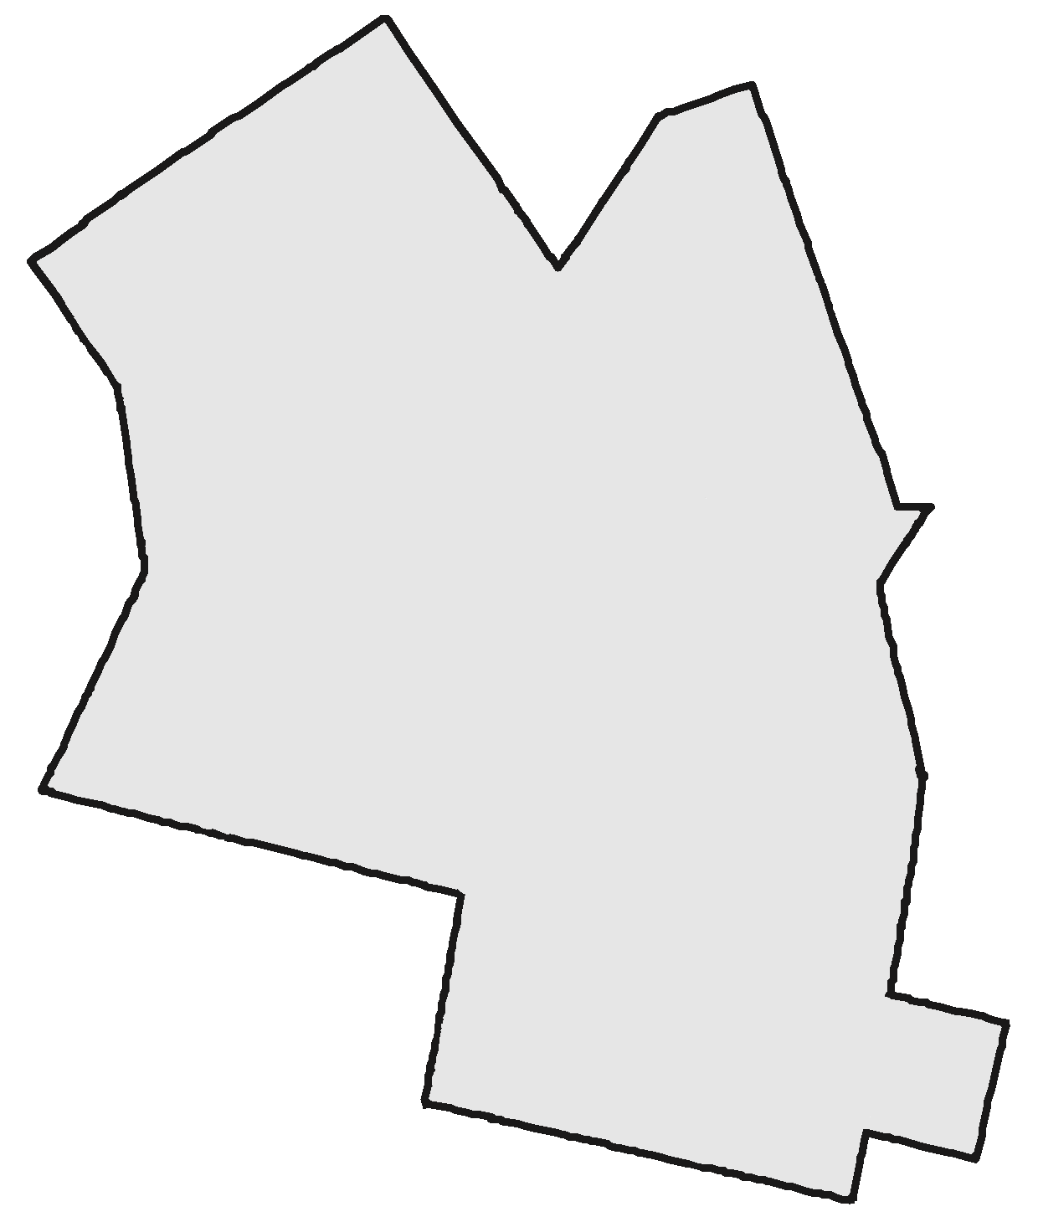
Multi-Member Systems
Combine several ridings into one
Elect the same total number of MPs
Example: Waterloo Region (Waterloo, Kitchener Centre,
Kitchener South - Hespeler, Kitchener-Conestoga, Cambridge)
Notes:
The core idea of the Multi-Member systems is combining several ridings into one but electing the same number of MPs. Thus one riding will have multiple members of parliament representing it.
[Click] Let’s take Waterloo Region as an example. The Region is made up of five ridings that would be combined into a single riding.
[Click] In the 2015 election, these five ridings elected four Liberals and a Conservative. The question is, [Click] how would we elect five MPs if we could do it as a group rather than each one individually, as in first-past-the-post.

Slide 16
Multi-Member Systems
Notes:
[Click] We commented earlier how unfair first-past-the-post was on the national scale with the Liberals gaining 54% of the seats with less than 40% of the vote.
In Waterloo Region it was much worse. The Liberals gained 80% of the seats with only 46% of the vote.
This came, of course, at the expense of the Conservatives, NDP, and Greens.

Slide 17
Multi-Member Systems
Notes:
[Click] We would be much closer to proportional if we had elected 2 Conservatives, 2 Liberals, and an NDP. It’s not perfectly proportional, but it’s much closer.
The question is, how do we count our votes to arrive at this more-or-less proportional result?

Slide 18
Types of Electoral Systems
Electoral Systems
Winner-Take-All Systems
Proportional
Systems
First-Past-The-Post
Alternative Vote
Multi-Member
Mixed Member
Rural-Urban Proportional
Notes:
[Click] The first thing to know is that there are many different electoral systems. They break down into two main families,
[Click] winner-take-all, and [Click] proportional systems.
In the winner-take-all family the most prominent system is known as [Click] first-past-the-post. It’s what Canada uses now.
Another winner-take-all-system that has received attention recently is known as [Click] alternative vote. It’s also known as instant run-off voting. There are other winner-take-all systems, as indicated by these extra boxes.
In the proportional family of electoral systems, [Click] one group is multi-member systems and the other is [Click] mixed member systems.
Again, there are many variations on these systems. We’ll look at one representative from each group.
=============== BACKGROUND
The first family is Majoritarian systems (like we have now) that elect a single person for each riding and each election is completely independent of all the others. First-Past-The-Post or FPTP is what Canada uses now. A variation of that system, Alternative Vote, is often talked about as an improvement on FPTP. Fair Vote believes that any proportional system is far better than any majoritarian system, including the Alternative Vote.
The second family of voting systems is Proportional Systems. There are at least two clans within this family. We’ll take a look at a representative member of each clan.
Alternative Vote is stacked in the graphic because there are a bunch of ways to count a ranked ballot. For example:
Successively dropping the candidate with the fewest first-place votes (AV)
Successively dropping the candidate with the most last-place votes
Ranked pairs (a version of Condorcet)
Borda count
Approval voting
Etc
However, these all elect a single person to represent the whole riding – and are thus not that different from FPTP. Almost everything in this list is better than AV, but not by much.
Similarly, Multi-Member and Mixed Member are stacked because there are also many variations on what we present here.
It’s worth stressing that there are many ways to do PR and that we can tailor a system to Canada.

Slide 19
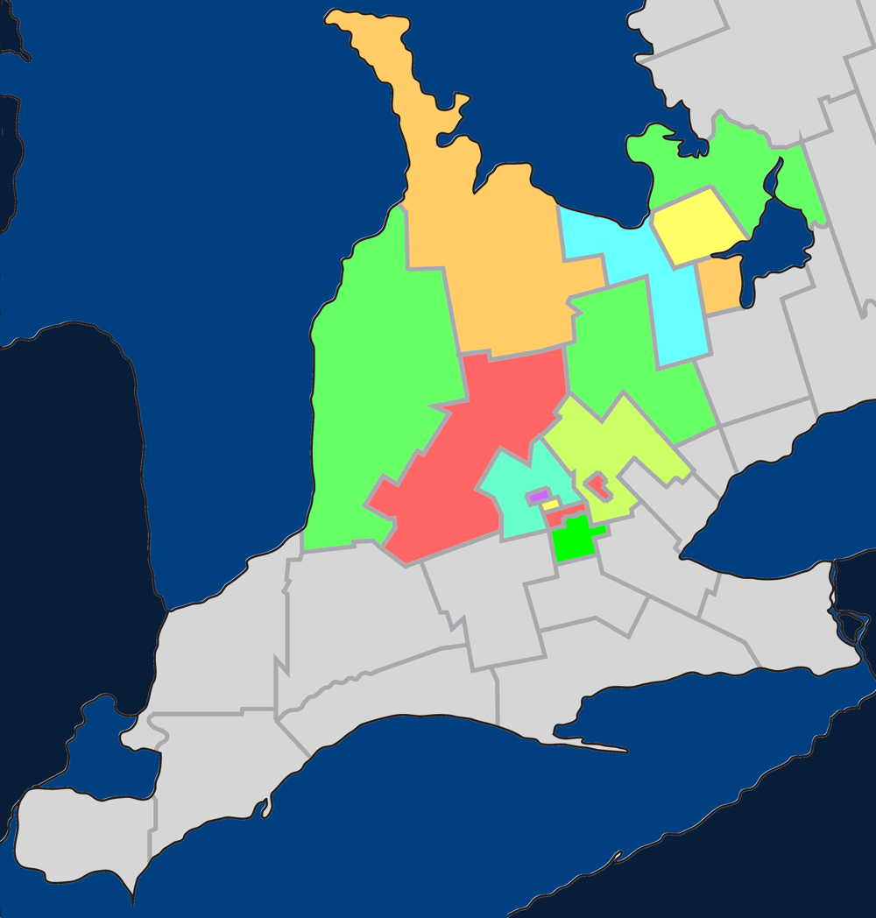
Mixed Member Proportional
Single-member
ridings in a multi-
member region
Example: Southern
Ontario
Notes:
Mixed Member Proportional system borrows ideas from our current first-past-the-post approach and from multi-member systems.
[Click] It does this by having single-member ridings within a multi-member region.
[Click] To understand what that means, let’s look at Southern Ontario as an example. [Click] In particular, we’ll look at a region with 15 ridings.

Slide 20
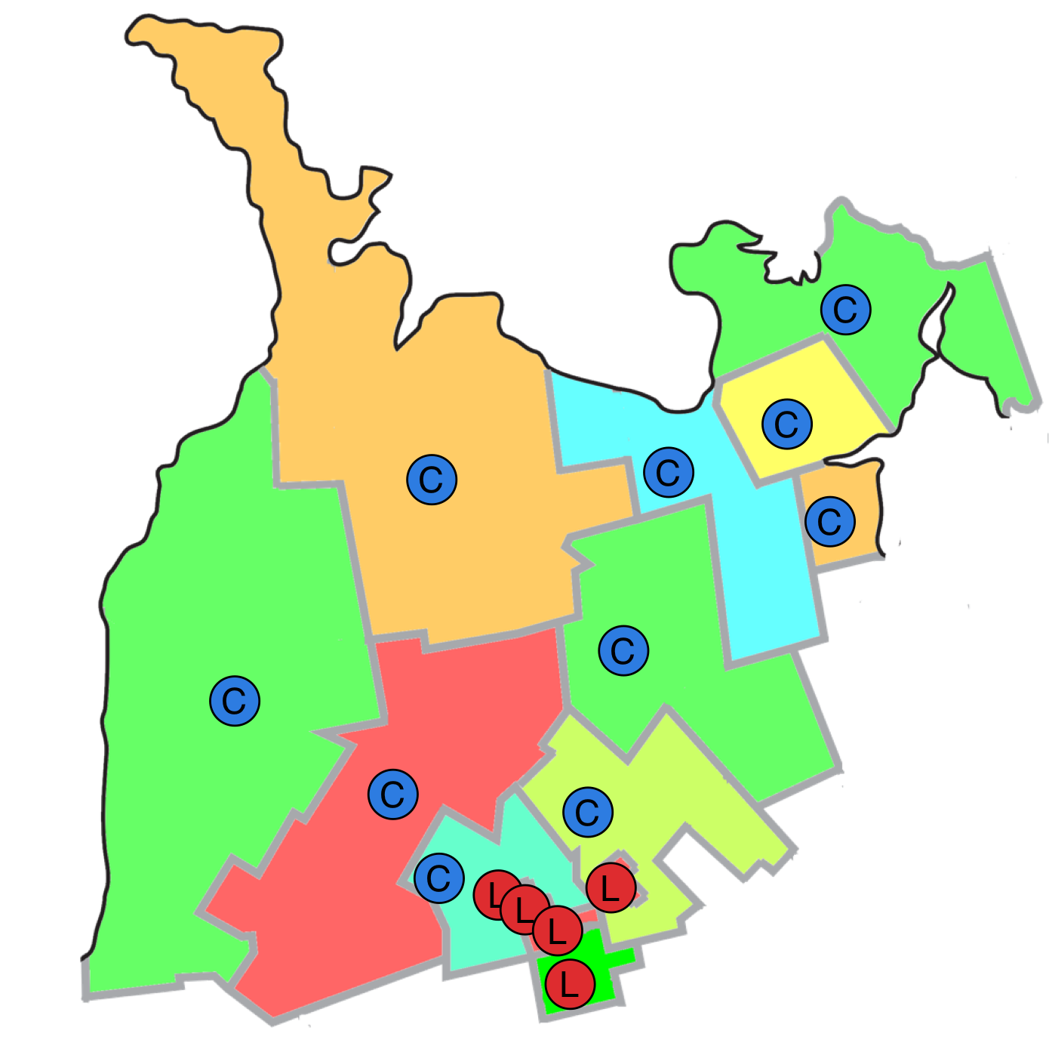
Mixed Member Proportional
Single-member
ridings in a multi-
member region
Example: Southern
Ontario
Notes:
[Click] We know how things went in these 15 ridings in the 2015 Federal Election: 5 went to Liberal candidates, 10 to Conservative candidates, and none to any of the other parties.

Slide 21

Mixed Member Proportional
Notes:
[Click] This makes the local results much more skewed than the nation as a whole. Within this region Liberals earned 42% of the votes – just a hair more than the Conservatives – and yet the Conservatives received twice as many seats in Parliament.

Slide 22
Mixed-Member Proportional
Single-member ridings in a multi-member region
15 MPs
  10 in single-member ridings
  5 in the region-at-large
  Regional MPs are chosen to ensure proportionality
Notes:
[Click] Mixed Member Proportional addresses this by continuing to have 15 MPs, but 10 of them would be in single-member ridings and 5 of them would be for the region at large. The Regional MPs are chosen to ensure overall proportionality with the popular vote.

Slide 23
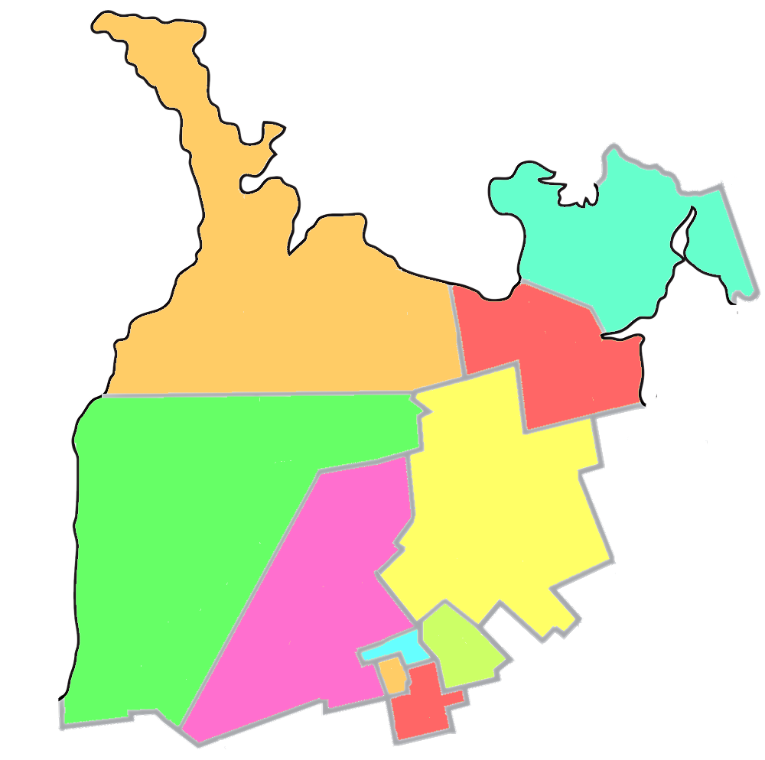

Mixed-Member Proportional
Notes:
[Click] This means that each riding becomes half again as large. Here’s how the region might be redistributed from 15 ridings into 10 ridings.
[Click] We could guess that these 10 ridings would have elected six Conservative MPs and four Liberal MPs in the last election. Each of those would have been elected using first-past-the-post, our current system.
[Click] The question is, how do we elect the remaining five MPs?

Slide 24
Mixed Member Proportional
Notes:
[Click] If we were to allocate the 15 seats proportionally, we’d give 6 to the Liberals and 6 to the Conservatives. The NDP would have 2 and the Greens 1.
[Click] Here’s how we think the riding seats would have been allocated; but how about the five regional seats?
[Click] Recall that they are chosen to maintain the overall proportionality between MPs and the popular vote.
[Click] Because the Conservatives received 6 riding seats, they don’t get any regional seats. They already have their fair share. The Liberals and NDP, however, each receive two regional seats while the Greens receive 1.

Slide 25
Recap
Top-down description:
  Divide the country/province into regions, each with 8 – 20 seats
  Set aside 1/2 to 2/3 of the seats for local, single-seat ridings
  The remaining seats represent the region at large and are chosen to make the number of seats held by each party proportional to the vote.
Bottom-up description:
  Take existing ridings and make them bigger (fewer seats)
  Group the ridings into regions
  The “extra” seats in each region represent the region as a whole and are filled to make the overall result proportional

Slide 26
Filling Seats: Closed List
Everyone has two votes:
  Local riding
  Party Proportionality
Riding Seats:
  Filled by
  local candidate with
  the most votes
Regional Seats:
  …
Notes:
[Click] That’s the goal – but how do we achieve it?
Everyone has two votes.
[Click] The first vote is for the MP to represent your riding. That vote would be just like now -- you vote for one person; whoever receives the most votes in your riding becomes your MP.
[Click] The second vote is for the party you prefer. This is the vote that’s used to calculate the proportional results – how many MPs each party should have for the region.

Slide 27
Filling Seats: Closed List
Before the election, parties make an ordered list of their candidates
  Prepared by party brass, or…
  Ordered by votes in nomination contests, or…
After voting, remove candidates that won a local seat
Take as many candidates as needed from the top of each party’s list to make results proportional
Conserv.
  Cohn
  Cooper
  Chong
  Chae
  Ceniza
  Cathers
  Cimino
  Church
  Clarke
  Classen
  Cizmarov
Liberal
  Long
  Laverty
  Lawson
  Lapp
  Laroque
  Leis
  Leferink
  Linton
  Lind
  Lynn
  Lukic
NDP
  Nabers
  Noble
  Nunn
  Nikolic
  Nguyen
  Nickel
  Ng
  Nabbi
  Near
  Nazar
  Nutt
Conserv.
  Cohn
  Cooper
  Chong
  Chae
  Ceniza
  Cathers
  Cimino
  Church
  Clarke
  Classen
  Cizmarov
Liberal
  Long
  Laverty
  Lawson
  Lapp
  Laroque
  Leis
  Leferink
  Linton
  Lind
  Lynn
  Lukic
NDP
  Nabers
  Noble
  Nunn
  Nikolic
  Nguyen
  Nickel
  Ng
  Nabbi
  Near
  Nazar
  Nutt
Conserv.
  Cohn
  Cooper
  Chong
  Chae
  Ceniza
  Cathers
  Cimino
  Church
  Clarke
  Classen
  Cizmarov
Liberal
  Long
  Laverty
  Lawson
  Lapp
  Laroque
  Leis
  Leferink
  Linton
  Lind
  Lynn
  Lukic
NDP
  Nabers
  Noble
  Nunn
  Nikolic
  Nguyen
  Nickel
  Ng
  Nabbi
  Near
  Nazar
  Nutt
Notes:
This text hasn’t been updated to match the slide.

Slide 28
Filling Seats: Open List
Everyone has two votes:
  Local riding
  Regional Candidate
Riding Seats:
  Local candidate with most votes
Regional Seats:
  Count total votes for each party
  Calculate number of regional seats for each party to be proportional
  Fill party’s regional seats with their candidates that have the most votes but didn’t win locally
Notes:
[Click] That’s the goal – but how do we achieve it?
Everyone has two votes.
[Click] The first vote is for the MP to represent your riding. That vote would be just like now -- you vote for one person; whoever receives the most votes in your riding becomes your MP.
[Click] The second vote is for the party you prefer. This is the vote that’s used to calculate the proportional results – how many MPs each party should have for the region.

Slide 29
Filling Seats: List-Free
Everyone has one vote:
  Local riding
Riding Seats:
  Local candidate with most votes
Regional Seats:
  Count total votes for each party
  Calculate number of regional seats for each party to be proportional
  Fill regional seats with party candidates who received the most votes but did not win
Notes:
[Click] That’s the goal – but how do we achieve it?
Everyone has two votes.
[Click] The first vote is for the MP to represent your riding. That vote would be just like now -- you vote for one person; whoever receives the most votes in your riding becomes your MP.
[Click] The second vote is for the party you prefer. This is the vote that’s used to calculate the proportional results – how many MPs each party should have for the region.

Slide 30
Mixed Member Design Decisions
Design Decision: Region size
Larger Regions
Smaller Regions
Smaller
Proportionality
More
Less
Regional Ballot Size
Larger
Smaller
Regional MP Accountability
Diffuse
More Local
Most proposals are for regions with 12 – 15 seats.
Notes:
This text hasn’t been updated to match the slide.

Slide 31
Mixed Member Design Decisions
Design Decision: Ratio of Regional Seats
More Regional Seats
More Local Seats
Smaller
Proportionality
More
Less
Local Riding Size
(assuming no change in total seats)
Larger
Smaller
Varies between roughly 30% and 50% regional seats. About 40% seems to be the sweet spot.
33% = ridings average 1.5x larger
50% = ridings average 2x larger
Notes:
This text hasn’t been updated to match the slide.

Slide 32
Mixed Member Design Decisions
Design Decision: Rounding Formula
Issue:
  Conservatives deserve 5.54 seats
  Liberals deserve 5.40 seats
  NDP deserve 2.56 seats
  Greens deserve 1.60 seats
  Who gets the last two seats?
Several possibilities: highest remainder (Greens + NDP), highest averages method, etc.
Some give slight preferences to large parties; others to smaller parties.
Smaller
Notes:
This text hasn’t been updated to match the slide.

Slide 33
Mixed Member Design Decisions
Design Decision: Threshold
Should a party be required to earn a certain percentage of the total vote, say 5%, before they receive a top-up seat?
Prevents parties with a regional stronghold from gaining a seat.
  A bigger issue for list-based PR systems like Israel.
Smaller
Notes:
This text hasn’t been updated to match the slide.

Slide 34
Mixed Member Design Decisions
Design Decision: Ballots
Either the local or regional ballot could use preferential ballots – voters rank the candidates. Should they?
  In local ridings, this is Alternative Vote.
  Leads to less proportionality but the idea of everyone having a (manufactured) majority appeals to many.
  In regions, this is like STV (Single Transferable Vote) within each party. Someone who is everyone’s second choice might win over two polarizing figures that have more first-choice votes.
Smaller
Notes:
This text hasn’t been updated to match the slide.

Slide 35
Mixed-Member Proportional

Slide 36
Mixed vs Multi-Member Systems
Mixed-Member Systems
Proportional
Keeps benefits of local members; familiarity of FPTP
Regional members ensure everyone is represented
Maintains centrality of the party
Multi-Member Systems
Proportional
Candidate-centred rather than party-centred
Everyone has multiple members; choose best for the situation
More incentives for civility and collaboration

Slide 37
Value | Definition | Winner Take All | Propor-tional
Effectiveness & Legitimacy | fairly translate votes into representatives | ✗ | ✔
Engagement | encourage voting foster greater civility and collaboration enhance social cohesion include underrepresented groups | ✗ ✗ ✗ ✗ | ✔ ✔ ✔ ✔
Accessibility & Inclusiveness | avoid undue voting complexity while respecting other principles | ✔ ✗ | ? ✔
Integrity | safeguard trust in the election process give reliable and verifiable results | ✔ ✔ | ✔ ✔
Local Representation | ensure accountable MPs ensure accessible (like-minded) MPs MPs understand local conditions & advance local needs | ? ✗ ✔ | ? ✔ ✔
Good Governance | yield stable governments governments that enact long-lasting policies supported by the majority of voters | ✔ ✗ | ✔ ✔
Notes:
Fairly translate votes: With FPTP a party can get 100% of the power with only 40% of the votes. In proportional systems, each party’s proportion of power matches their proportion of the seats.
Encourage voting: With majoritarian systems, many of our votes don’t affect the outcome of the election and some of us have never helped elect a winning candidate. In proportional systems our votes count, which encourages people to vote. Democracies using proportional systems typically have voter turnout rates of 7-8% higher than ours.
Foster greater civility and collaboration: When parties can get 100% of the power with only 40% of the vote, there is tremendous incentive to trash talk the other parties in hopes of short-term gain. With proportional systems, that short-term gain simply isn’t there. Parties have to learn to work together.
Enhance Social cohesion: Our current system magnifies regional differences. Alberta looks more conservative than it really is. Toronto looks more Liberal. PR represents our country as it really is, which I believe is more cohesive than it feels under FPTP.
Include underrepresented groups: Internationally, we observe that majoritarian countries elect far fewer women than PR countries. If we adopted PR, we could expect the number of women in parliament to rise, along with members of various minority groups.
Voting complexity: FPTP is about as easy as it gets – but that simplicity comes at the cost of unfair elections, reduced representation of women and other groups, and many other ill effects. Some forms of PR are just as simple for the voter as FPTP. All of them have been mastered by the citizens of other countries and can be mastered by Canadians as well.
Integrity: All of these systems can be implemented to safeguard the integrity of the election process.
Accountable MPs: All of the systems have MPs that face the voters and can be thrown out if not doing a good job.
Accessible MPs: In our current system, every voter has an MP they can go to but there is no assurance that MP is like-minded enough to understand the voter’s perspective. In proportional systems most voters are represented by an MP with a similar world view.
Local conditions: Like the previous point, winner-take-all systems elect MPs that have one particular view of local conditions and needs but may not really understand the views of half of their constituents. So I’ve given winner-tak—all systems a question mark. PR systems have multiple people representing a local area, but they are also less local and so perhaps don’t understand the issues quite as well.
Stable governments: International comparisons indicate both systems yield stable governments.
Long-lasting policies: However, winner-take-all systems suffer from policy lurch where a government with a false majority implements policies that are not truly supported by a majority. When they are eventually swept from power their policies are often reversed by the next government. This makes planning for businesses, public institutions, and even families hard. PR, on the other hand, tends to be much more collaborative with longer-lasting policies.

Slide 38
Summary
Proportional electoral systems satisfy our criteria much better than majoritarian systems like FPTP and Alternative Vote.
The exception is simplicity
  Voters in many other countries have figured it out
  Voting is not that much more complex; counting the vote is the responsibility of Elections Canada
There are different kinds of PR – with real differences – but ANY form of PR meets the established criteria better than FPTP or AV.
Notes:
This text hasn’t been updated to match the slide.
[Click] To summarize,
[Click] Our current system often gives results that are very different from the popular vote. Less than 40% of Canadian voters voted for the Liberals in the 2015 election or the Conservatives in the 2011 election. Yet in both cases they received a majority in parliament and 100% of the power.
[Click] By over-representing some voices, other voices are necessarily diminished, limiting the diversity that research shows is important for good decision-making.
[Click] The Alternative Vote has been promoted as a remedy with the flawed reasoning that a manufactured consensus is good enough. But in practise, it gives the same results as first-past-the-post without solving any of its problems.
[Click] Finally, in winner-take-all systems the votes for losing candidates are ignored and have no influence on the direction of the country. That is, many votes simply don’t count. Lots of business-oriented research shows that a group of diverse-thinking people make better decisions that a more homogenous group. See, for example, http://www.scientificamerican.com/article/how-diversity-makes-us-smarter/

Slide 39
Questions
&
Responses

Slide 40

More Information
Electoral Reform Committee
http://www.parl.gc.ca/Committees/en/ERRE
Fair Vote Canada:
https://fairvote.ca
Fair Voting BC:
https://fairvotingbc.com/
Local PR:
http://localpr.ca/
Election Modelling:
http://election-modelling.ca/
Notes:
MMP Video: www.youtube.com/watch?v=D3guVBhKmDc
STV video: www.youtube.com/watch?v=bLH_w5kHJpA
Evidence Summary: docs.google.com/document/d/1YfCj0cx4XDqJDDwFV9kRoRDyHxJ2azxuny6EQjwu6v8/edit?usp=sharing
Recent Research: docs.google.com/document/d/1_86RnPYohC3dkuihEZXrP82s5AP6kO5jE-DMW7_S7uw/edit?usp=sharing
[Perhaps show this slide as soon as questions have started. ]

Slide 41
Acknowledgements
Author: Byron Weber Becker
Research, editorial advice, project management: Sharon Sommerville, Bob Jonkman, Sean Haberlin, Gordon Divitt, Holly Featherstone, and many other members of Fair Vote Waterloo Region
To the extent possible under law, Byron Weber Becker has waived all copyright and related or neighboring rights to this Presentation. This work is published from: Canada.
See http://creativecommons.org/publicdomain/zero/1.0/

