Slide 1
Simulating Canadian Elections
Byron Weber Becker
bwbecker@election-modelling.ca
Notes:
[Note: Feel free to adapt this introduction to suit yourself. A personal story about why you are concerned about PR is a wonderful start.]
Hello! My name is _________________ and I’m delighted to be here to discuss making every vote count.

Slide 2
Outline
Overview of electoral systems
  Which electoral systems are other countries using?
  FPTP
  Alternative Vote
  Multi-member ridings
  Mixed systems
Simulations
  Conceptual model
  Gallagher Index & Composite Gallagher Index
  Synthetic Elections
  Limitations
Q&A
Notes:
[Click] The outline for the presentation is to:
[Click] talk more about the criteria by which we might evaluate parliament
[Click] look at the systems other countries are using
[Click] explore how those systems work
[Click] ask whether they deliver the kind of parliament Canadians want
We’ll close with a brief summary and a time for questions. Questions of clarification are also welcome as we go along.

Slide 3

Types of Electoral Systems
Electoral Systems
Winner-Take-All Systems
Proportional
Systems
First-Past-The-Post
Alternative Vote
Multi-Member
Mixed Member
Rural-Urban Proportional
Notes:
[Click] The first thing to know is that there are many different electoral systems. They break down into two main families,
[Click] winner-take-all, and [Click] proportional systems.
In the winner-take-all family the most prominent system is known as [Click] first-past-the-post. It’s what Canada uses now.
Another winner-take-all-system that has received attention recently is known as [Click] alternative vote. It’s also known as instant run-off voting. There are other winner-take-all systems, as indicated by these extra boxes.
In the proportional family of electoral systems, [Click] one group is multi-member systems and the other is [Click] mixed member systems.
Again, there are many variations on these systems. We’ll look at one representative from each group.
=============== BACKGROUND
The first family is Majoritarian systems (like we have now) that elect a single person for each riding and each election is completely independent of all the others. First-Past-The-Post or FPTP is what Canada uses now. A variation of that system, Alternative Vote, is often talked about as an improvement on FPTP. Fair Vote believes that any proportional system is far better than any majoritarian system, including the Alternative Vote.
The second family of voting systems is Proportional Systems. There are at least two clans within this family. We’ll take a look at a representative member of each clan.
Alternative Vote is stacked in the graphic because there are a bunch of ways to count a ranked ballot. For example:
Successively dropping the candidate with the fewest first-place votes (AV)
Successively dropping the candidate with the most last-place votes
Ranked pairs (a version of Condorcet)
Borda count
Approval voting
Etc
However, these all elect a single person to represent the whole riding – and are thus not that different from FPTP. Almost everything in this list is better than AV, but not by much.
Similarly, Multi-Member and Mixed Member are stacked because there are also many variations on what we present here.
It’s worth stressing that there are many ways to do PR and that we can tailor a system to Canada.

Slide 4
Who is Using What?
Winner-Take-All Systems:
First-Past-The-Post:
  United States
  Canada
  Singapore
  United Kingdom
Alternative Vote:
  Australia
Other:
  France, Bahrain, Belarus
Proportional Systems:
Multi-Member
  Norway
  Switzerland
  Denmark
  Netherlands
  Ireland
  Liechtenstein
  Sweden
  Iceland
  Israel
  Luxembourg
  Belgium
  Austria
  Finland
  Slovenia
  Spain
  Italy
  Czech Republic
  Greece
  Estonia
  Cyprus
  Slovakia
  Poland
  Malta
  Argentina
  United Arab Emirates
  Chile
  Portugal
  Latvia
  Croatia
  Kuwait
  Montenegro
Mixed Member
  Germany
  New Zealand
  Hungary
Parallel Systems
  South Korea
  Japan
  Andorra
  Lithuania
Looking at democracies scoring “very high” on the UN’s Human Development Index.
Notes:
[Click] But first, which countries are already using these systems?
For this comparison, we’re really interested in countries like Canada – similar in values, life style, and (of course) democracies. We’re using countries ranked “very high” on the United Nation’s Human Development index as a benchmark.
[Click] Let’s look first at countries using a Winner-Take-All system.
On the UN’s Human Development Index, there are four countries that use first-past-the-post. [Click] Canada, of course, the United States, Singapore and the United Kingdom. All four have close historical ties in the development of their democracies.
[Click] The only country on the list to use the Alternative Vote is Australia.
[Click] A couple use a two-round system that we won’t discuss.
[Click] On the other hand, here are all the countries on the UN list that use some form of proportional representation. Some of the prominent ones are New Zealand, Germany, and many other European countries.
[We have received gasps of surprise at this last one. Be sure to stay here long enough for it to sink in!]
[Click] Finally, there are a couple that use Parallel systems that mix winner-take-all and proportional.
==================
Notes: Within each group the countries are listed in HDI order.
How this list was created:
Take the countries ranked “very high” on the UN’s Human Development Index (http://www.nationsonline.org/oneworld/human_development.htm; actual list from https://en.wikipedia.org/wiki/List_of_countries_by_Human_Development_Index). Remove non-democracies like Saudia Arabia, UAE, Qatar, Cuba. Cross-reference that with http://www.idea.int/db/fieldview.cfm?field=154#tableTab1 to get the electoral system used.
There are lots of other countries that use FPTP, but they aren’t high on the UN’s Human Development Index – in other words most of us would not choose to live in those countries unless we had family or something there.
The Human Development Index (HDI) is a summary measure of average achievement in key dimensions of human development: (1) a long and healthy life, (2) being knowledgeable and (3) have a decent standard of living. (http://hdr.undp.org/en/content/human-development-index-

Slide 5
Types of Electoral Systems
Electoral Systems
Winner-Take-All Systems
Proportional
Systems
First-Past-The-Post
Alternative Vote
Multi-Member
Mixed Member
Rural-Urban Proportional
Notes:
[Click] The first thing to know is that there are many different electoral systems. They break down into two main families,
[Click] winner-take-all, and [Click] proportional systems.
In the winner-take-all family the most prominent system is known as [Click] first-past-the-post. It’s what Canada uses now.
Another winner-take-all-system that has received attention recently is known as [Click] alternative vote. It’s also known as instant run-off voting. There are other winner-take-all systems, as indicated by these extra boxes.
In the proportional family of electoral systems, [Click] one group is multi-member systems and the other is [Click] mixed member systems.
Again, there are many variations on these systems. We’ll look at one representative from each group.
=============== BACKGROUND
The first family is Majoritarian systems (like we have now) that elect a single person for each riding and each election is completely independent of all the others. First-Past-The-Post or FPTP is what Canada uses now. A variation of that system, Alternative Vote, is often talked about as an improvement on FPTP. Fair Vote believes that any proportional system is far better than any majoritarian system, including the Alternative Vote.
The second family of voting systems is Proportional Systems. There are at least two clans within this family. We’ll take a look at a representative member of each clan.
Alternative Vote is stacked in the graphic because there are a bunch of ways to count a ranked ballot. For example:
Successively dropping the candidate with the fewest first-place votes (AV)
Successively dropping the candidate with the most last-place votes
Ranked pairs (a version of Condorcet)
Borda count
Approval voting
Etc
However, these all elect a single person to represent the whole riding – and are thus not that different from FPTP. Almost everything in this list is better than AV, but not by much.
Similarly, Multi-Member and Mixed Member are stacked because there are also many variations on what we present here.
It’s worth stressing that there are many ways to do PR and that we can tailor a system to Canada.

Slide 6
First-Past-The-Post
Canada uses FPTP now
In each riding, the candidate with the most votes wins
  Each riding decides independently of all other ridings
Notes:
[Click] FPTP is the system that Canada has used since 1867. It’s a simple system – in each riding the candidate with the most votes wins and becomes the MP for that riding.
That simplicity, however, produces many ill effects. It’s important that we take a few moments to understand them.

Slide 7
FPTP results are often unfair
“False Majority”
Notes:
[Click] This charts shows the results of the 2015 Federal election. The bottom set of bars shows that the Liberals earned about 40% of the popular vote but received 54% of the seats in Parliament.
Those extra seats came at the expense of the Conservatives, New Democrats, Bloc, and Green candidates – who all received fewer seats than their share of the popular vote would indicate.
To make matters worse, the first-past-the-post system turned that 40% minority of the votes into a majority of the seats in Parliament. That is, the Liberals received 100% of the power in Parliament with less than 40% of the votes.
When this happens, it’s called a “False Majority”. [Click]
By the way, that’s almost exactly what happened in the previous election except that the Conservatives received 100% of the power with just under 40% of the votes.

Slide 8
FPTP results are often unfair
“False Majority”
Notes:
[Click] This charts shows the results of the 2011Federal election. Almost exactly the same as 2015, just the colours are different!

Slide 9
FPTP false majorities are common
Notes:
[Click] We could hope that false majorities would be rare – but they are not. Since 1930, half of our governments have been false majorities. Of the 26 elections since 1930, only 4 of them have resulted in a true majority government.

Slide 10
FPTP Instability
100 Voters
40 Liberal
35 Conservative
25 NDP
Variations in voter distribution give the “right” results (sometimes).
Notes:
This group of three slides illustrate how arbitrary FPTP can be. It assumes the same election – 100 voters distributed between three parties – and shows how the outcome depends completely on how those voters are distributed between the ridings.
In this slide the voters are distributed more-or-less randomly between the ridings nd the election comes out basically as it should – two Liberals, two Conservatives, and a New Democrat. That’s close to proportional.

Slide 11
FPTP Instability
100 Voters
40 Liberal
35 Conservative
25 NDP
Perfectly even voter distributions give every riding to the same party.
Notes:
But if the voters are distributed perfectly evenly across the five ridings, the result is a Liberal sweep!

Slide 12
FPTP Instability
100 Voters
40 Liberal
35 Conservative
25 NDP
Uneven voter distributions can give skewed or wrong results.
Notes:
But if it’s only the Liberals that are evenly distributed, they can get completely shut out – in spite of having the most votes!
I (Byron, the author) think this instability makes FPTP completely unsuitable as an election mechanism. By “instability” I mean that the results depend on completely arbitrary factors like how the voters are distributed around the country.

Slide 13
FPTP magnifies regional differences
Notes:
FPTP can make us appear much more divided than we really are, undermining our social cohesion.

Slide 14
FPTP tends to elect few women
Notes:
[Click] Let’s shift now to the other way of looking at diversity: does Parliament approximately match the diversity of Canadians in gender, ethnicity, orientation, religion, or any other measure one might reasonably propose?
One of our most basic identities is gender. This slide compares the percentage of women elected to national legislatures in eleven different countries. We see that those countries using some form of proportional representation elect more women than those using a single-winner system like first-past-the-post.
First-past-the-post fails to fairly reflect our diversity.
================= Background
This data is from page 9 of Fair Vote Canada’s publication “A Case for Support – A Case for Democracy”, published Nov. 2014.
The 2015 election barely changed these numbers. Canada got up to 26% women in Parliament.

Slide 15
Comparing models…???

Slide 16
Types of Electoral Systems
Electoral Systems
Winner-Take-All Systems
Proportional
Systems
First-Past-The-Post
Alternative Vote
Multi-Member
Mixed Member
Rural-Urban Proportional
Notes:
[Click] The first thing to know is that there are many different electoral systems. They break down into two main families,
[Click] winner-take-all, and [Click] proportional systems.
In the winner-take-all family the most prominent system is known as [Click] first-past-the-post. It’s what Canada uses now.
Another winner-take-all-system that has received attention recently is known as [Click] alternative vote. It’s also known as instant run-off voting. There are other winner-take-all systems, as indicated by these extra boxes.
In the proportional family of electoral systems, [Click] one group is multi-member systems and the other is [Click] mixed member systems.
Again, there are many variations on these systems. We’ll look at one representative from each group.
=============== BACKGROUND
The first family is Majoritarian systems (like we have now) that elect a single person for each riding and each election is completely independent of all the others. First-Past-The-Post or FPTP is what Canada uses now. A variation of that system, Alternative Vote, is often talked about as an improvement on FPTP. Fair Vote believes that any proportional system is far better than any majoritarian system, including the Alternative Vote.
The second family of voting systems is Proportional Systems. There are at least two clans within this family. We’ll take a look at a representative member of each clan.
Alternative Vote is stacked in the graphic because there are a bunch of ways to count a ranked ballot. For example:
Successively dropping the candidate with the fewest first-place votes (AV)
Successively dropping the candidate with the most last-place votes
Ranked pairs (a version of Condorcet)
Borda count
Approval voting
Etc
However, these all elect a single person to represent the whole riding – and are thus not that different from FPTP. Almost everything in this list is better than AV, but not by much.
Similarly, Multi-Member and Mixed Member are stacked because there are also many variations on what we present here.
It’s worth stressing that there are many ways to do PR and that we can tailor a system to Canada.

Slide 17
Alternative Vote
Uses a ranked ballot
When counted, the candidate with the least votes is dropped and those ballots redistributed to the next ranked candidate. Repeat until someone has 50%+1.
Notes:
[Click] Alternative Vote uses a ranked ballot, which is different from what we’re used to. Many other electoral systems also use a ranked ballot.
[Click] A ranked ballot simply means that voters can say who their second, third, and fourth choices are – in addition to their first choice.
[Click] These choices are taken into account when the ballots are counted. The general idea of Alternative Vote is to count the ballots using the top-ranked remaining candidate on each ballot. If a candidate gets 50%+1, he or she wins. Otherwise, drop the least popular candidate, redistribute those ballots, and count again.
Let’s look at an example.

Slide 18
Alternative Vote Counting
Con 38%
NDP 29%
Lib 26%
Grn 5%
Ind 2%
1%
1%
Con 39%
NDP 29%
Lib 26%
Grn 6%
1%
5%
Con 40%
NDP 29%
Lib 31%
8%
21%
Con 48%
Lib 52%
Notes:
[Click] In this election, the conservative candidate received 38% of the first-place votes, the NDP candidate received 29% of the first place votes, and so on for the other candidates.
The Independent candidate is least popular and is dropped. [Click] The 2% of the ballots that listed the Independent candidate first are redistributed to their second place candidate. Let’s suppose that half of them go to the Greens and half to the Conservatives.
[Click] We now pretend that first round never happened. At this point we pretend that 39% ranked the Conservative candidate first, even though we know that some of them really ranked them second.
Once again, we drop the least popular candidate, in this case the Green. Their votes are redistributed.
[Click] We’re now left with 40% for the Conservative candidate, 29% for the NDP, and 31% for the Liberal candidate. [Click] Once again, we drop the least popular candidate and redistribute their votes, giving the Liberal candidate the win (in this example).

Slide 19
Alternative Vote Results
Favours centrist parties over others
Simulation using 2015 data gives Liberals 213 seats instead of 184 (24% over-representation instead of 15%).
Notes:
[Click] Alternative Vote has been used in Australia and a number of municipalities. In those jurisdictions it has usually elected the same candidate that would have won under first-past-the-post.
In those cases where it does elect someone different – like in our example, it tends to favour bigger parties and centrist candidates. A simulation with 2015 data shows the Liberals gaining even more undeserved seats.
Because it generally elects the same candidate as first-past-the-post, it’s subject to the same results: unfair representation, limited diversity, and many voters without a like-minded representative.
Note: Greens, for example, won’t do any better under AV than FPTP unless they substantially increase their vote share.

Slide 20
But people will vote differently!
E1: 12% of voters shift from Liberal to Green
E2: 8% of voters shift from Liberal to Green
E3: 4% of voters shift from Liberal to Green
E4: 2015 election
http://election-modelling.ca/av/index.html
Notes:
This is a complicated graph. I’m happy to discuss it in more detail at the end of the presentation. For now, I’ll just say that it takes a lot of people voting differently to overcome the unfairness that is built into Alternative Vote.
Background:
This is based on 6 simulations of Alternative Vote using the 2015 data. In each case a different percentage of the votes in each riding are shifted. For example, at the far left, 30% of the Liberal votes in each riding are shifted to the NDP – and the Liberals still get more MPs than they should (light red line vs. heavier read line).
On the right side of the graph, votes are shifted from the NDP to the Liberals – with devastating effects on the NDP.

Slide 21
Comparing models…???

Slide 22
Types of Electoral Systems
Electoral Systems
Winner-Take-All Systems
Proportional
Systems
First-Past-The-Post
Alternative Vote
Multi-Member
Mixed Member
Rural-Urban Proportional
Notes:
[Click] The first thing to know is that there are many different electoral systems. They break down into two main families,
[Click] winner-take-all, and [Click] proportional systems.
In the winner-take-all family the most prominent system is known as [Click] first-past-the-post. It’s what Canada uses now.
Another winner-take-all-system that has received attention recently is known as [Click] alternative vote. It’s also known as instant run-off voting. There are other winner-take-all systems, as indicated by these extra boxes.
In the proportional family of electoral systems, [Click] one group is multi-member systems and the other is [Click] mixed member systems.
Again, there are many variations on these systems. We’ll look at one representative from each group.
=============== BACKGROUND
The first family is Majoritarian systems (like we have now) that elect a single person for each riding and each election is completely independent of all the others. First-Past-The-Post or FPTP is what Canada uses now. A variation of that system, Alternative Vote, is often talked about as an improvement on FPTP. Fair Vote believes that any proportional system is far better than any majoritarian system, including the Alternative Vote.
The second family of voting systems is Proportional Systems. There are at least two clans within this family. We’ll take a look at a representative member of each clan.
Alternative Vote is stacked in the graphic because there are a bunch of ways to count a ranked ballot. For example:
Successively dropping the candidate with the fewest first-place votes (AV)
Successively dropping the candidate with the most last-place votes
Ranked pairs (a version of Condorcet)
Borda count
Approval voting
Etc
However, these all elect a single person to represent the whole riding – and are thus not that different from FPTP. Almost everything in this list is better than AV, but not by much.
Similarly, Multi-Member and Mixed Member are stacked because there are also many variations on what we present here.
It’s worth stressing that there are many ways to do PR and that we can tailor a system to Canada.

Slide 23
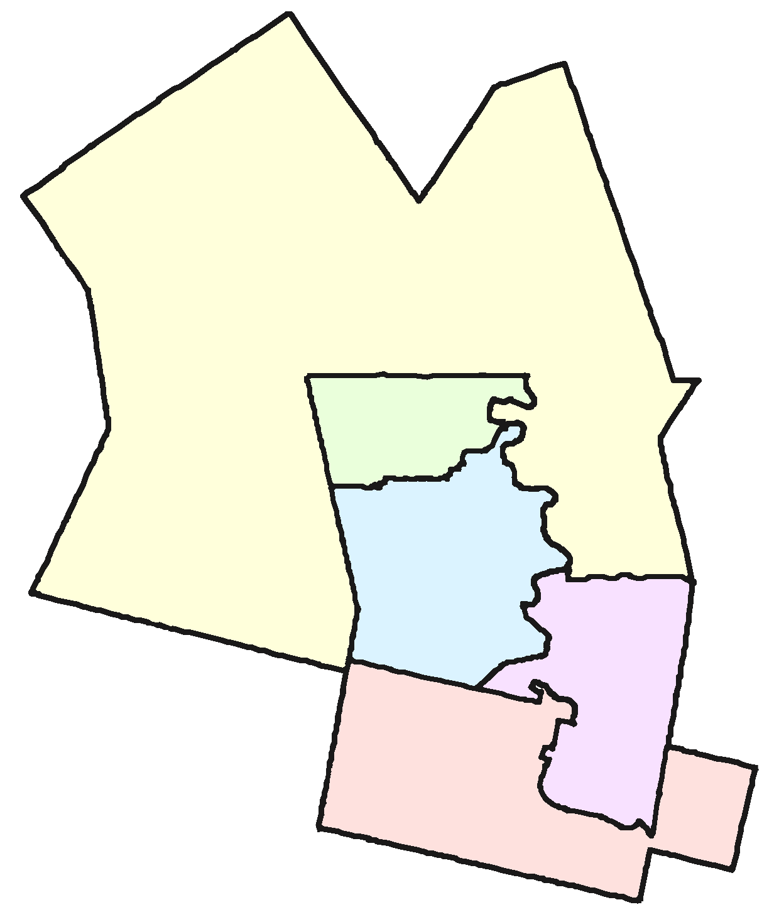
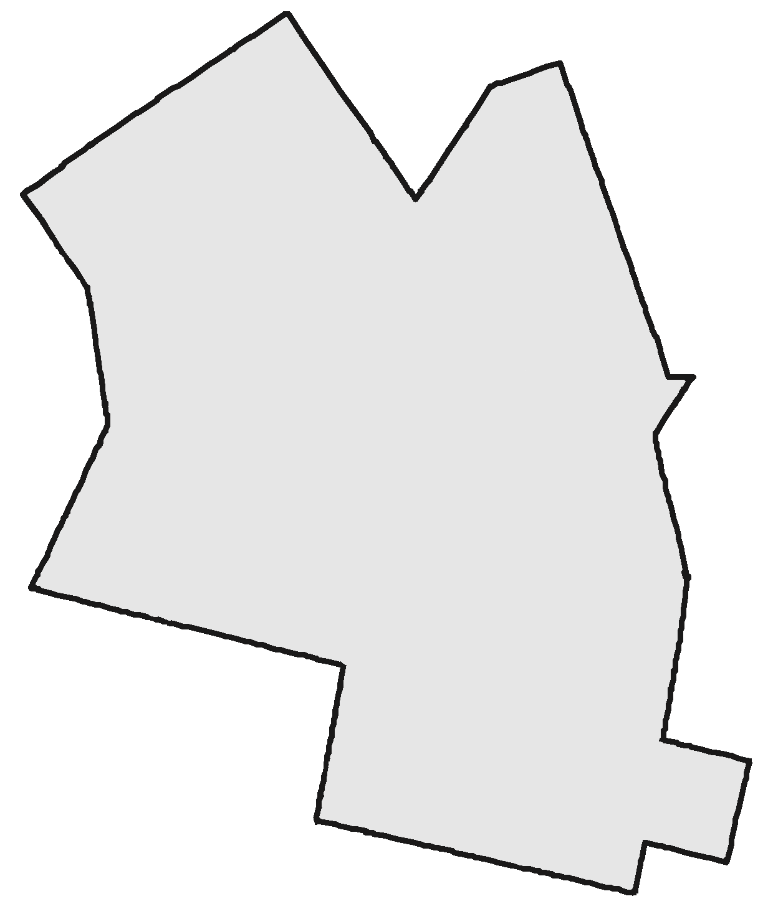
Multi-Member Systems
Combine several ridings into one
Elect the same total number of MPs
Example: Waterloo Region (Waterloo, Kitchener Centre, Kitchener-South Hespeler, Kitchener-Conestoga, Cambridge)
Notes:
The core idea of the Multi-Member systems is combining several ridings into one but electing the same number of MPs. Thus one riding will have multiple members of parliament representing it.
[Click] Let’s take Waterloo Region as an example. The Region is made up of five ridings that would be combined into a single riding.
[Click] In the 2015 election, these five ridings elected four Liberals and a Conservative. The question is, [Click] how would we elect five MPs if we could do it as a group rather than each one individually, as in first-past-the-post.

Slide 24
Multi-Member Systems
Notes:
[Click] We commented earlier how unfair first-past-the-post was on the national scale with the Liberals gaining 54% of the seats with less than 40% of the vote.
In Waterloo Region it was much worse. The Liberals gained 80% of the seats with only 46% of the vote.
This came, of course, at the expense of the Conservatives, NDP, and Greens.

Slide 25
Multi-Member Systems
Notes:
[Click] We would be much closer to proportional if we had elected 2 Conservatives, 2 Liberals, and an NDP. It’s not perfectly proportional, but it’s much closer.
The question is, how do we count our votes to arrive at this more-or-less proportional result?

Slide 26
Multi-Member Systems
Many ways to fairly elect five winners. (Closed List)
Conservative (36%)
  Charles Cooper
  Carrie Cohn
  Caleb Chong
Green (3%)
  Gary Gronau
  Greta Gill
Liberal (46%)
  Lily Laverty
  Logan Long
  Lisa Lawson
New Democrats (14%)
  Norman Nabers
  Nicole Noble
  Nina Nunn

Slide 27
Multi-Member Systems
Many ways to fairly elect five winners. (Open List)
Conservative
  Charles Cooper (13%)
  Carrie Cohn (12%)
  Caleb Chong (11%)
Green
  Gary Gronau (3%)
  Greta Gill (1%)
Liberal
  Lily Laverty (30%)
  Logan Long (10%)
  Lisa Lawson (6%)
New Democrats
  Norman Nabers (8%)
  Nina Nunn (4%)
  Nicole Noble (2%)
Notes:
Mark your favourite candidate.
List is ranked within parties in order by the number of votes received.
Take the top n candidates from each party’s list.

Slide 28
Multi-Member Systems
Many ways to fairly elect five winners. (Single Transferrable Vote)
Similar to Alternative Vote:
Allocate ballots to 1st choice candidates
While (seats left to fill):
  If a hopeful candidate has quota:
    Declare candidate elected
    Transfer surplus votes
  Else:
    Drop candidate with fewest votes
    Transfer votes
Notes:
Mark your favourite candidate.
List is ranked within parties in order by the number of votes received.
Take the top n candidates from each party’s list.

Slide 29
Comparing models…???

Slide 30
Types of Electoral Systems
Electoral Systems
Winner-Take-All Systems
Proportional
Systems
First-Past-The-Post
Alternative Vote
Multi-Member
Mixed Member
Rural-Urban Proportional
Notes:
[Click] The first thing to know is that there are many different electoral systems. They break down into two main families,
[Click] winner-take-all, and [Click] proportional systems.
In the winner-take-all family the most prominent system is known as [Click] first-past-the-post. It’s what Canada uses now.
Another winner-take-all-system that has received attention recently is known as [Click] alternative vote. It’s also known as instant run-off voting. There are other winner-take-all systems, as indicated by these extra boxes.
In the proportional family of electoral systems, [Click] one group is multi-member systems and the other is [Click] mixed member systems.
Again, there are many variations on these systems. We’ll look at one representative from each group.
=============== BACKGROUND
The first family is Majoritarian systems (like we have now) that elect a single person for each riding and each election is completely independent of all the others. First-Past-The-Post or FPTP is what Canada uses now. A variation of that system, Alternative Vote, is often talked about as an improvement on FPTP. Fair Vote believes that any proportional system is far better than any majoritarian system, including the Alternative Vote.
The second family of voting systems is Proportional Systems. There are at least two clans within this family. We’ll take a look at a representative member of each clan.
Alternative Vote is stacked in the graphic because there are a bunch of ways to count a ranked ballot. For example:
Successively dropping the candidate with the fewest first-place votes (AV)
Successively dropping the candidate with the most last-place votes
Ranked pairs (a version of Condorcet)
Borda count
Approval voting
Etc
However, these all elect a single person to represent the whole riding – and are thus not that different from FPTP. Almost everything in this list is better than AV, but not by much.
Similarly, Multi-Member and Mixed Member are stacked because there are also many variations on what we present here.
It’s worth stressing that there are many ways to do PR and that we can tailor a system to Canada.

Slide 31
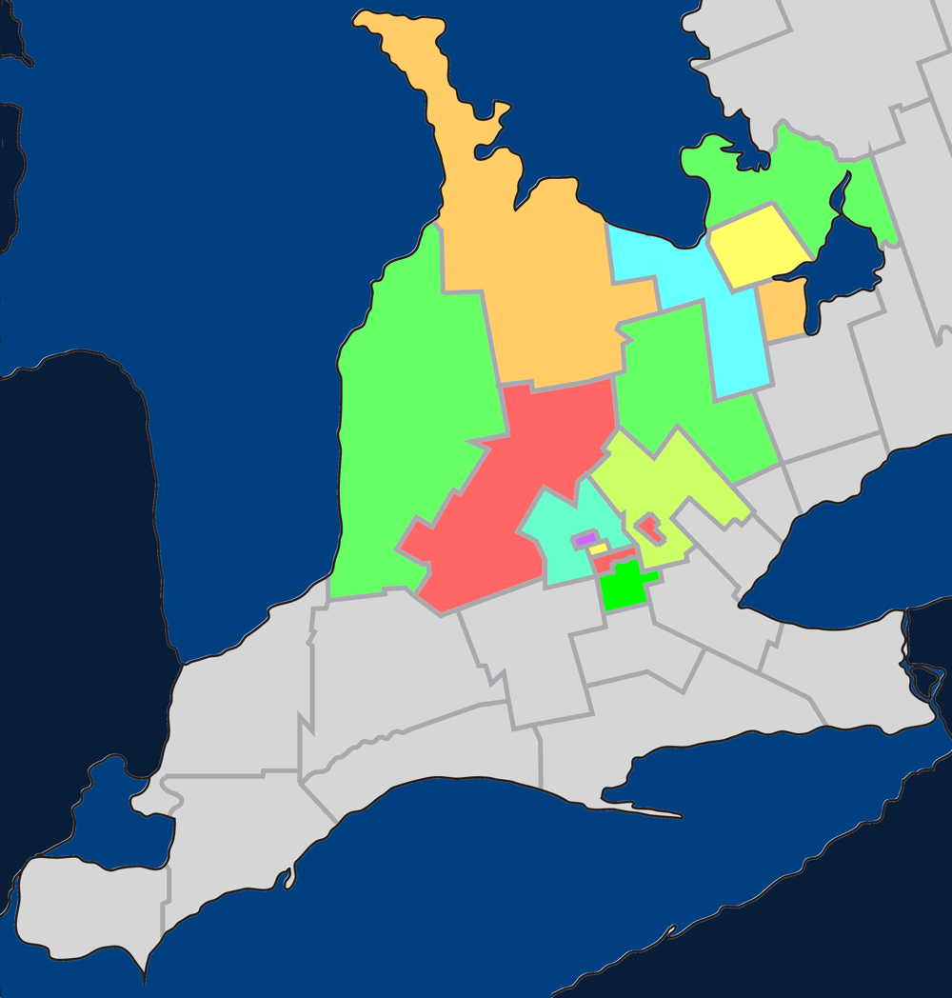
Mixed Member Proportional
Single-member
ridings in a multi-
member region
Example: Southern
Ontario
Notes:
Mixed Member Proportional system borrows ideas from our current first-past-the-post approach and from multi-member systems.
[Click] It does this by having single-member ridings within a multi-member region.
[Click] To understand what that means, let’s look at Southern Ontario as an example. [Click] In particular, we’ll look at a region with 15 ridings.

Slide 32
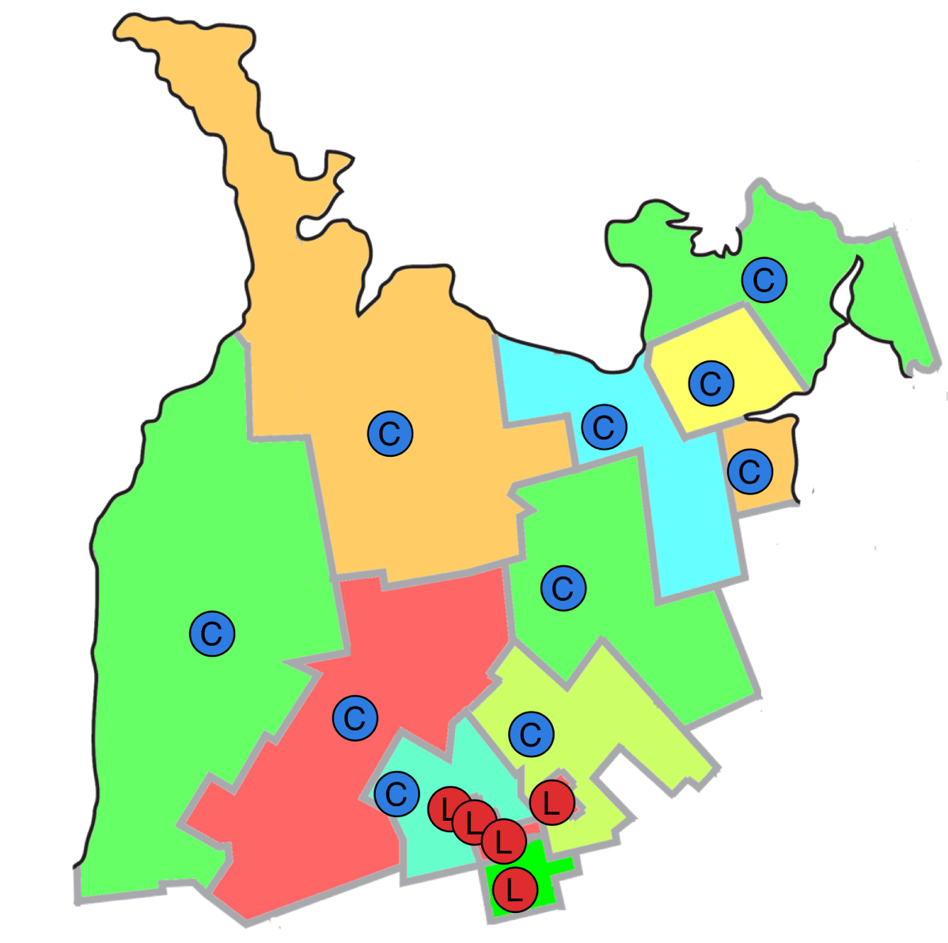
Mixed Member Proportional
Single-member
ridings in a multi-
member region
Example: Southern
Ontario
Notes:
[Click] We know how things went in these 15 ridings in the 2015 Federal Election: 5 went to Liberal candidates, 10 to Conservative candidates, and none to any of the other parties.

Slide 33

Mixed Member Proportional
Notes:
[Click] This makes the local results much more skewed than the nation as a whole. Within this region Liberals earned 42% of the votes – just a hair more than the Conservatives – and yet the Conservatives received twice as many seats in Parliament.

Slide 34
Mixed-Member Proportional
Single-member ridings in a multi-member region
15 MPs
  10 in single-member ridings
  5 in the region-at-large
  Regional MPs are chosen to ensure proportionality
Notes:
[Click] Mixed Member Proportional addresses this by continuing to have 15 MPs, but 10 of them would be in single-member ridings and 5 of them would be for the region at large. The Regional MPs are chosen to ensure overall proportionality with the popular vote.

Slide 35
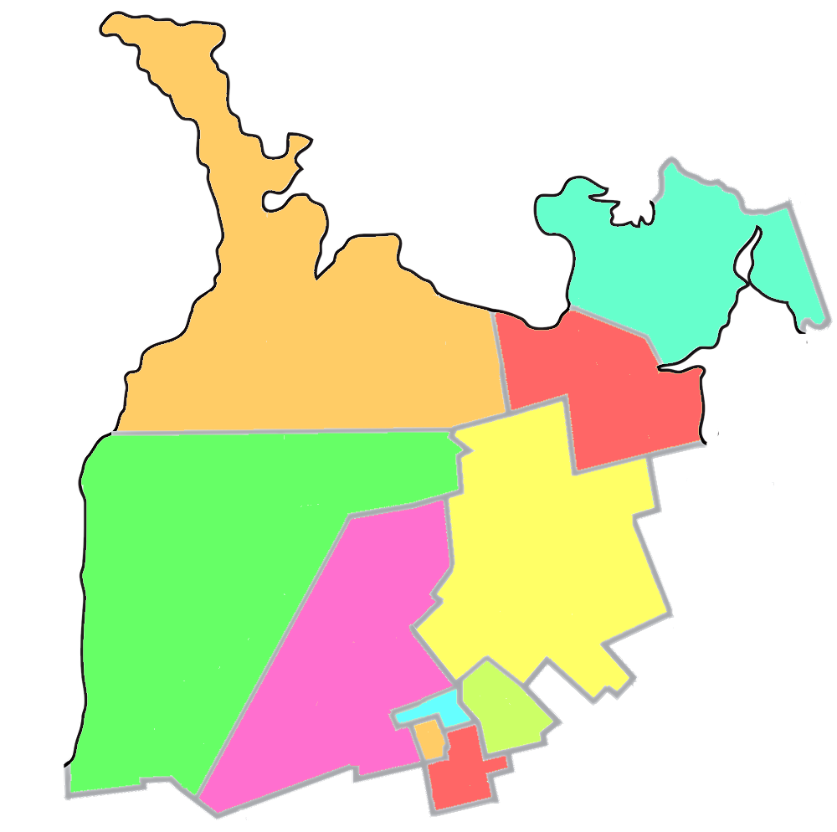

Mixed-Member Proportional
Notes:
[Click] This means that each riding becomes half again as large. Here’s how the region might be redistributed from 15 ridings into 10 ridings.
[Click] We could guess that these 10 ridings would have elected six Conservative MPs and four Liberal MPs in the last election. Each of those would have been elected using first-past-the-post, our current system.
[Click] The question is, how do we elect the remaining five MPs?

Slide 36
Mixed Member Proportional
Notes:
[Click] If we were to allocate the 15 seats proportionally, we’d give 6 to the Liberals and 6 to the Conservatives. The NDP would have 2 and the Greens 1.
[Click] Here’s how we think the riding seats would have been allocated; but how about the five regional seats?
[Click] Recall that they are chosen to maintain the overall proportionality between MPs and the popular vote.
[Click] Because the Conservatives received 6 riding seats, they don’t get any regional seats. They already have their fair share. The Liberals and NDP, however, each receive two regional seats while the Greens receive 1.

Slide 37
Mixed Member Proportional
Everyone has two votes:
  Local riding
  Party Proportionality
Notes:
[Click] That’s the goal – but how do we achieve it?
Everyone has two votes.
[Click] The first vote is for the MP to represent your riding. That vote would be just like now -- you vote for one person; whoever receives the most votes in your riding becomes your MP.
[Click] The second vote is for the party you prefer. This is the vote that’s used to calculate the proportional results – how many MPs each party should have for the region.

Slide 38
Filling regional seats
Make an ordered list for each party of all the candidates
Remove candidates that won a local seat
Take as many candidates as needed from the top of each party’s list to make results proportional
Ordering the lists:
  Closed List: Parties do it
  Open List: Voters do it
  List-Free: Remaining candidates with most votes
Conserv.
  Cohn
  Cooper
  Chong
  Chae
  Ceniza
  Cathers
  Cimino
  Church
  Clarke
  Classen
  Cizmarov
Liberal
  Long
  Laverty
  Lawson
  Lapp
  Laroque
  Leis
  Leferink
  Linton
  Lind
  Lynn
  Lukic
NDP
  Nabers
  Noble
  Nunn
  Nikolic
  Nguyen
  Nickel
  Ng
  Nabbi
  Near
  Nazar
  Nutt
Conserv.
  Cohn
  Cooper
  Chong
  Chae
  Ceniza
  Cathers
  Cimino
  Church
  Clarke
  Classen
  Cizmarov
Liberal
  Long
  Laverty
  Lawson
  Lapp
  Laroque
  Leis
  Leferink
  Linton
  Lind
  Lynn
  Lukic
NDP
  Nabers
  Noble
  Nunn
  Nikolic
  Nguyen
  Nickel
  Ng
  Nabbi
  Near
  Nazar
  Nutt
Conserv.
  Cohn
  Cooper
  Chong
  Chae
  Ceniza
  Cathers
  Cimino
  Church
  Clarke
  Classen
  Cizmarov
Liberal
  Long
  Laverty
  Lawson
  Lapp
  Laroque
  Leis
  Leferink
  Linton
  Lind
  Lynn
  Lukic
NDP
  Nabers
  Noble
  Nunn
  Nikolic
  Nguyen
  Nickel
  Ng
  Nabbi
  Near
  Nazar
  Nutt
Notes:
This text hasn’t been updated to match the slide.

Slide 39
Comparing models…???

Slide 40
Types of Electoral Systems
Electoral Systems
Winner-Take-All Systems
Proportional
Systems
First-Past-The-Post
Alternative Vote
Multi-Member
Mixed Member
Rural-Urban Proportional
Notes:
[Click] The first thing to know is that there are many different electoral systems. They break down into two main families,
[Click] winner-take-all, and [Click] proportional systems.
In the winner-take-all family the most prominent system is known as [Click] first-past-the-post. It’s what Canada uses now.
Another winner-take-all-system that has received attention recently is known as [Click] alternative vote. It’s also known as instant run-off voting. There are other winner-take-all systems, as indicated by these extra boxes.
In the proportional family of electoral systems, [Click] one group is multi-member systems and the other is [Click] mixed member systems.
Again, there are many variations on these systems. We’ll look at one representative from each group.
=============== BACKGROUND
The first family is Majoritarian systems (like we have now) that elect a single person for each riding and each election is completely independent of all the others. First-Past-The-Post or FPTP is what Canada uses now. A variation of that system, Alternative Vote, is often talked about as an improvement on FPTP. Fair Vote believes that any proportional system is far better than any majoritarian system, including the Alternative Vote.
The second family of voting systems is Proportional Systems. There are at least two clans within this family. We’ll take a look at a representative member of each clan.
Alternative Vote is stacked in the graphic because there are a bunch of ways to count a ranked ballot. For example:
Successively dropping the candidate with the fewest first-place votes (AV)
Successively dropping the candidate with the most last-place votes
Ranked pairs (a version of Condorcet)
Borda count
Approval voting
Etc
However, these all elect a single person to represent the whole riding – and are thus not that different from FPTP. Almost everything in this list is better than AV, but not by much.
Similarly, Multi-Member and Mixed Member are stacked because there are also many variations on what we present here.
It’s worth stressing that there are many ways to do PR and that we can tailor a system to Canada.

Slide 41
Rural-Urban PR
Made-in-Canada solution
Excellent proportionality
Address huge differences in riding sizes
  10km² up to 2,000,000km²
Combines features of Multi-Member and Mixed-Member
Use Alberta as an example

Slide 42
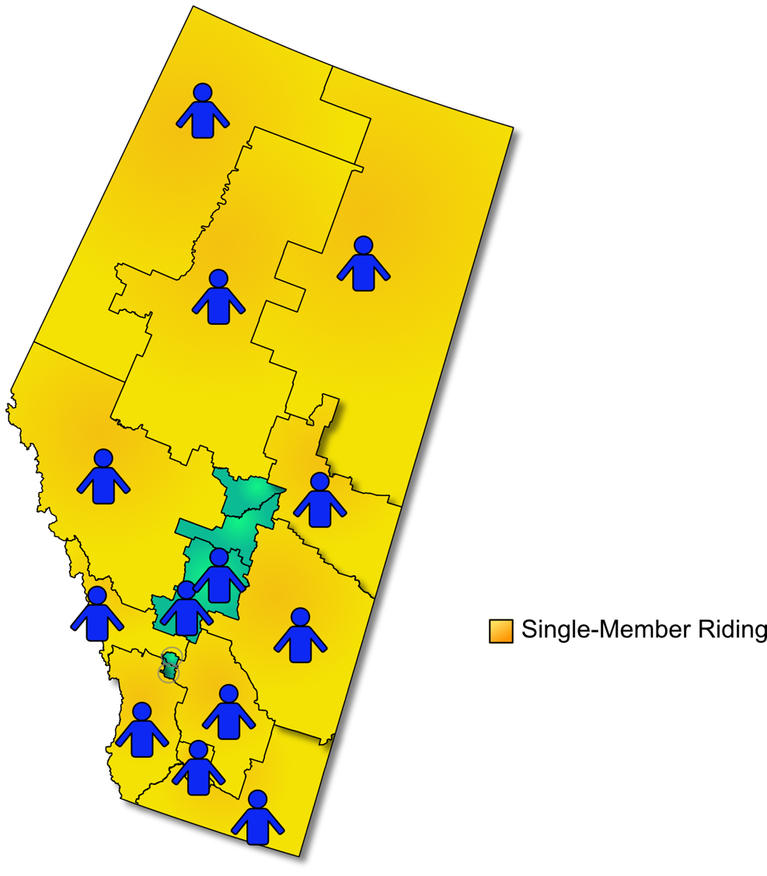
Rural-Urban PR
Step 1: Leave large ridings as single-member

Slide 43
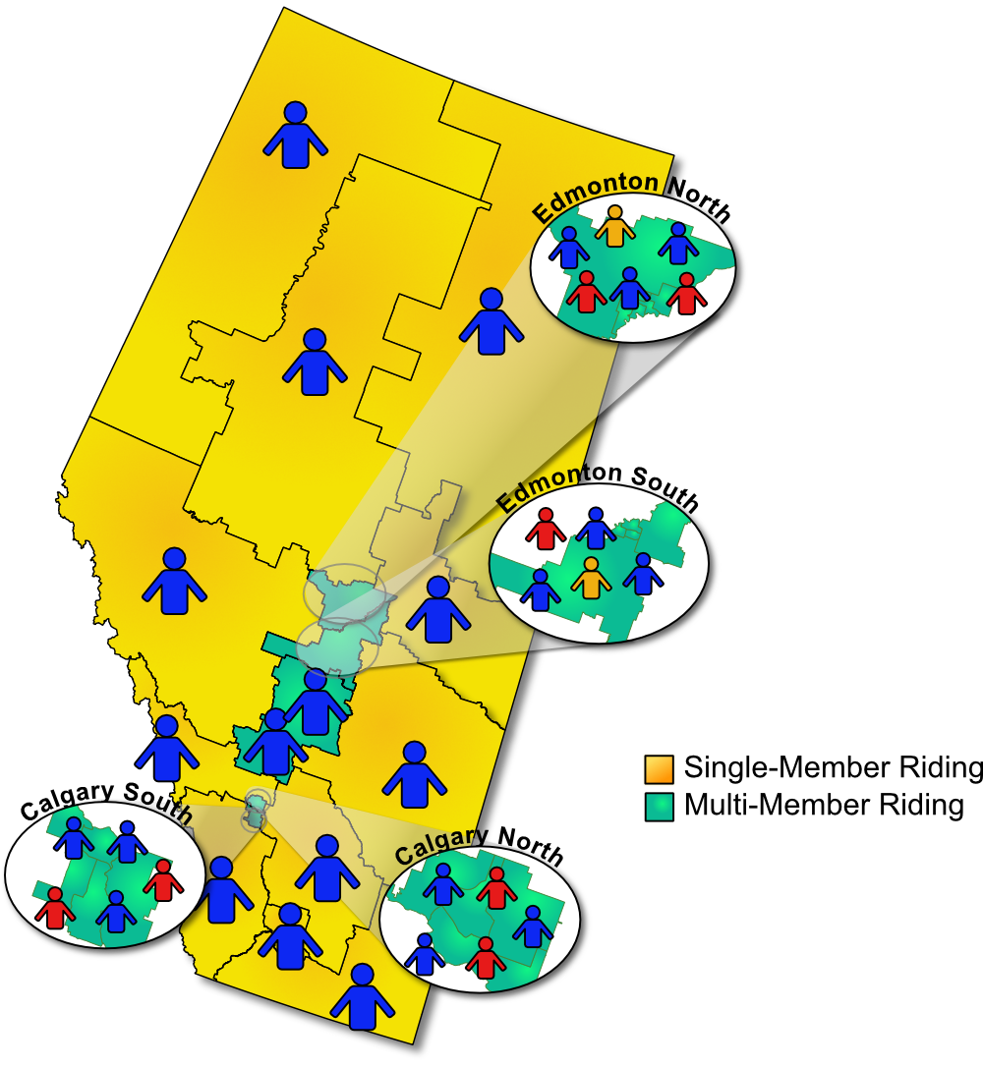
Rural-Urban PR
Step 1: Leave large ridings as single-member
Step 2: Combine densely populated areas into multi-member ridings

Slide 44
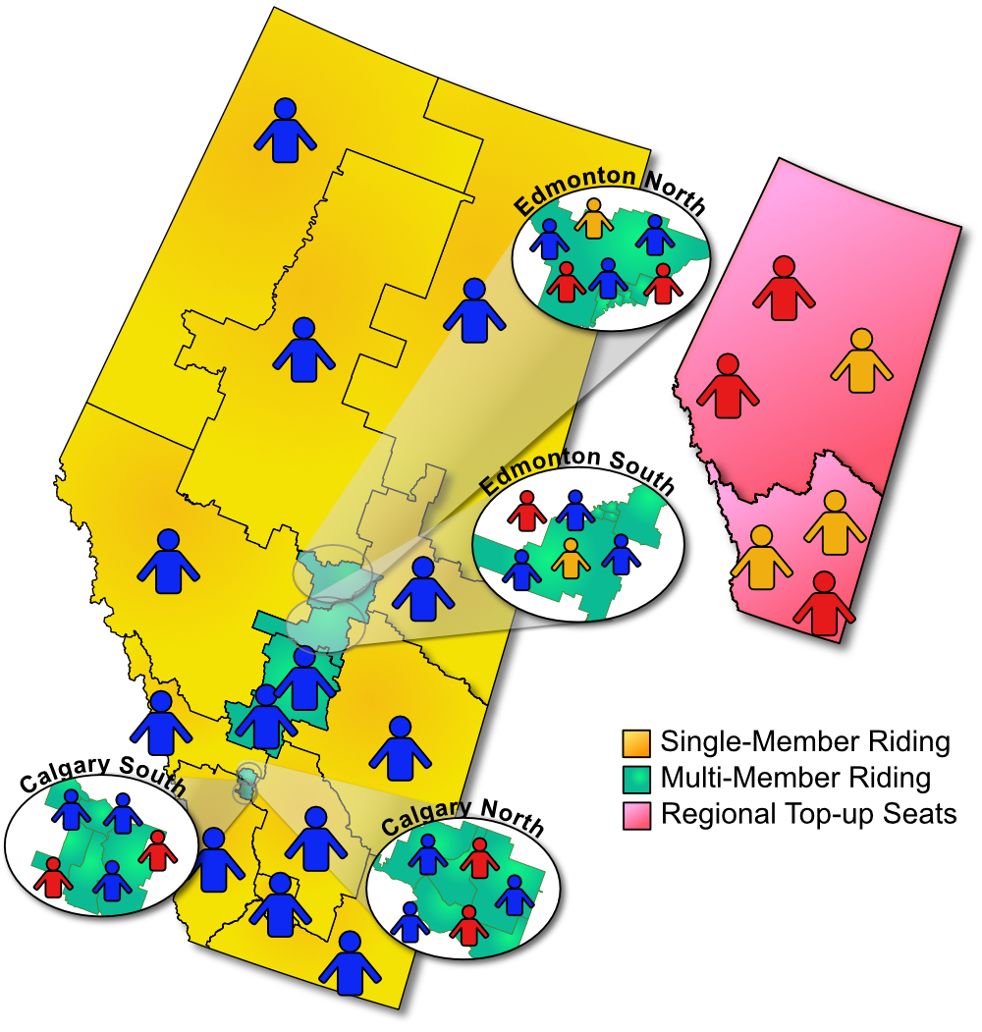
Rural-Urban PR
Step 1: Leave large ridings as single-member
Step 2: Combine densely populated areas into multi-member ridings
Step 3: Add top-up seats (like MMP)

Slide 45
Rural-Urban PR
Made-in-Canada solution
Excellent proportionality
Address huge differences in riding sizes
Dense ridings have ad-vantages of multi-member
Fewer top-up seats than MMP (feasible to just enlarge Parliament by 15%)
Smaller ridings than Multi-Member Systems

Slide 46
Comparing models…???

Slide 47
Modelling

Slide 48
Mappings
3
2
3
3
3
2
Map virtual ridings to regions.
Map regions to provinces.
Map real ridings to virtual ridings.
Specify # of top-up seats.
Specify district magnitudes.
Specify algorithms

Slide 49
Represent Mappings with JSON

Slide 50
Algorithms
Specify election algorithm to use at each level:
  Single-member ridings: FPTP, AV, N/A
  Multi-member ridings: STV, List, N/A, etc
  Regions: Top-up, N/A

Slide 51
Implementation
Coded in Scala
  Wonderful collections library
  Encourages functional programming
  Lots of recursion, maps etc. in the algorithms
  Do the election for each virtual riding in parallel
Define Scala case classes that correspond to the json. Compile-time macros construct functions to read the json and return objects.
Cool library to output HTML.

Slide 52
Output (STV)
See much more at election-modelling.ca

Slide 53
Output (STV)
See much more at election-modelling.ca

Slide 54
Output (STV)
See much more at election-modelling.ca

Slide 55
Output: Summary

Slide 56
Measuring Disproportionality
Nice to have a measure of disproportionality
Gallagher Index
  P = parties
  V = % vote earned by the party
  S = % seats awarded

Slide 57
Measuring Disproportionality
https://en.wikipedia.org/wiki/Gallagher_index

Slide 58
Measuring Disproportionality
VotesA = 100%
VotesB = 0%
SeatsA = 0%
SeatsB = 100%
GI = sqrt(0.5 ×
((VotesA-SeatsA)^2 + (VotesB-SeatsB)^2 ))
= 100

Slide 59
Composite Gallagher
But…
  Conservatives get way more seats than they should out west.
  Liberals get way more seats than they should in the east.
  Suppose that nationally each gets the percentage of seats they deserve
Gallagher Index = ~0
Solution:
  Calculate Gallagher Index for each province
  Take the weighted average
  I call this the “Composite Gallagher Index”
  2015: 12.0 vs. 17.2

Slide 60
Synthetic Elections: FPTP

Slide 61
Synthetic Elections: LPR+

Slide 62
Limitations
Changing the system will change how people vote
  We don’t know how
We don’t have good data on voter preferences
  Ekos polling data from Oct 14, 2015; lots changed by Oct 15!
  Only gave 2nd choice preferences; need 3rd and 4th too!
  Should vary by province
  Assumes another
  candidate of same party
  isn’t available
Should use more years
of data (I’ve done some with 2011, but more would be good)

Slide 63
Q& A

